Slide 1


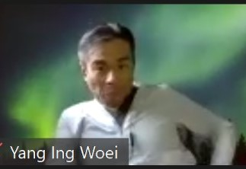

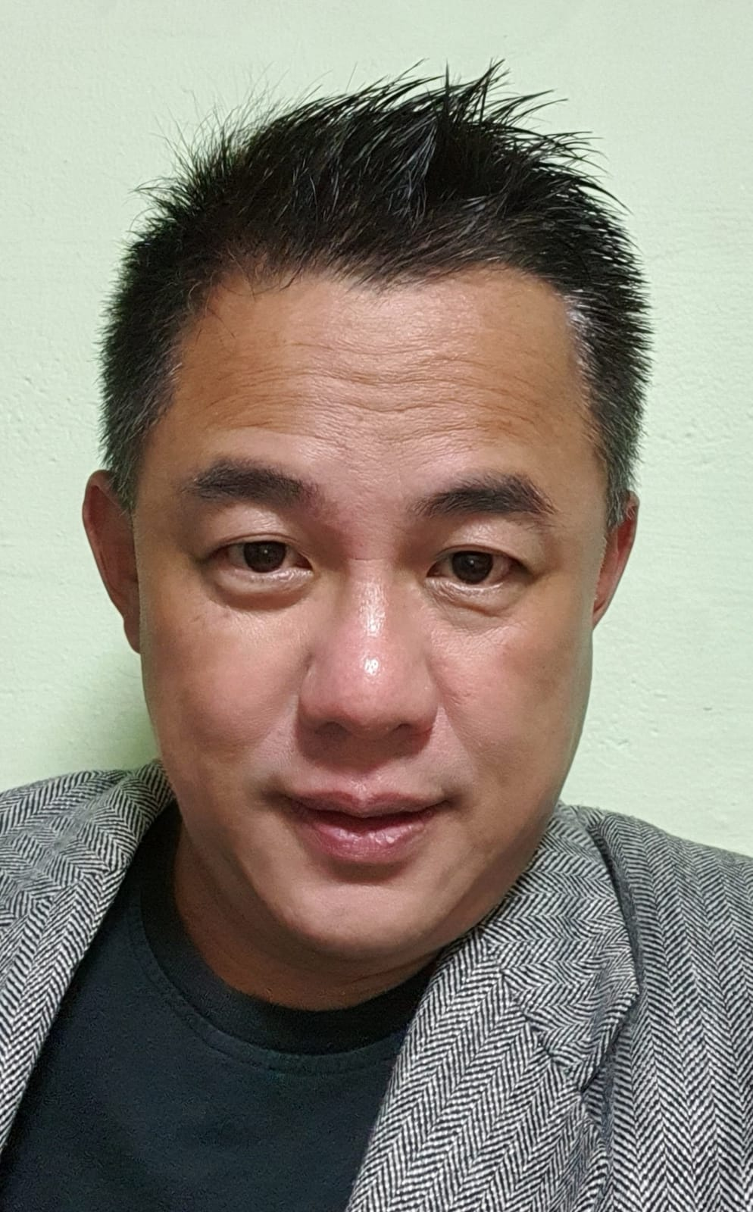


DATA SCIENCE PROJECT
“TELCO-CHURN”
SUBMITTED BY : AI0403 Batch - Team 2
Tang Kok Yong
Regina Sun Wei Ling
Yang Ing Woei
Shiji Ann Abraham
Wee Chi Yu
Ivy Tan Sor Tin
Yeo Khee Chye

Slide 2
CONTENTS
PLANNING ANALYTICS
BUSINESS PROBLEM Paul (Yang Ing Woei)
BUSINESS SOLUTION Shiji Ann Abraham
DESCRIPTIVE ANALYTICS Regina Sun Wei Ling
DIAGNOSTIC ANALYTICS Yeo Khee Chye
PREDICTIVE ANALYTICS Ivy Tan Sor Tin
Wee Chi Yu
PRESCRIPTIVE ANALYTICS Tang Kok Yong

Slide 3
Planning Analytics
Business Understanding
19 - (Paul) Yang Ing Woei - AI0403

Slide 4
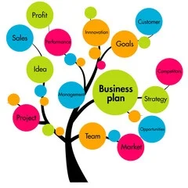
Planning Analytics
Business
Understanding

Slide 5
Business Case & Introduction
Companies lose $1.6 trillion per year due to customer churn ...
And according to the Forrester Market intel, it Costs 5 TIMES MORE to acquire new customers than it does to keep an existing one.

Slide 6
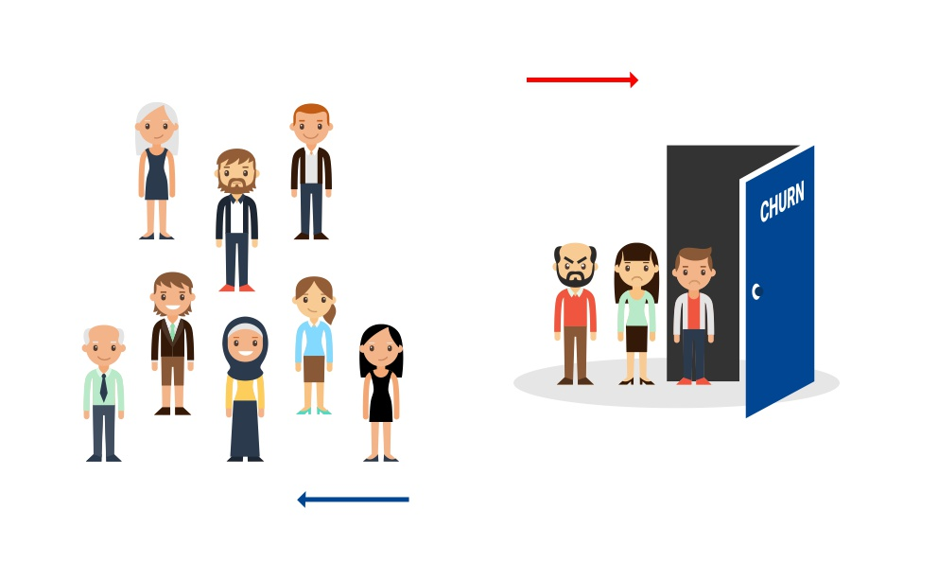
What is Customer churn ?

Slide 7

Customer churn
Customer churn is calculated by the number of customers who leave a company during a given time period. In a more down-to-earth sense, churn rate can show how your business is doing ...
In short , it costs too much to ignore customers who stop doing business with you

Slide 8

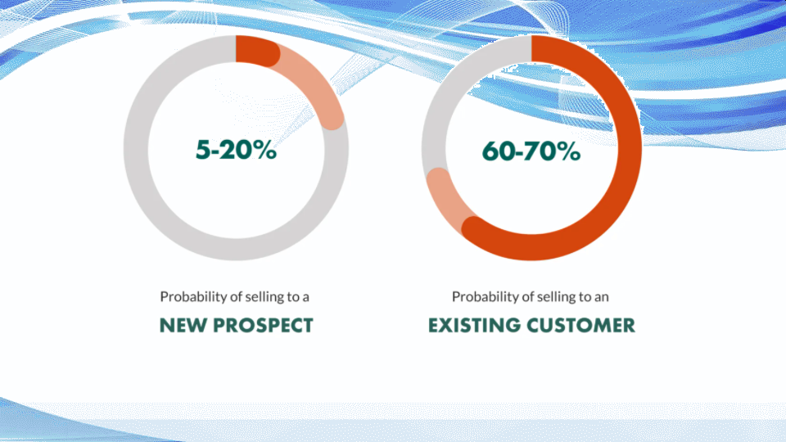

Slide 9

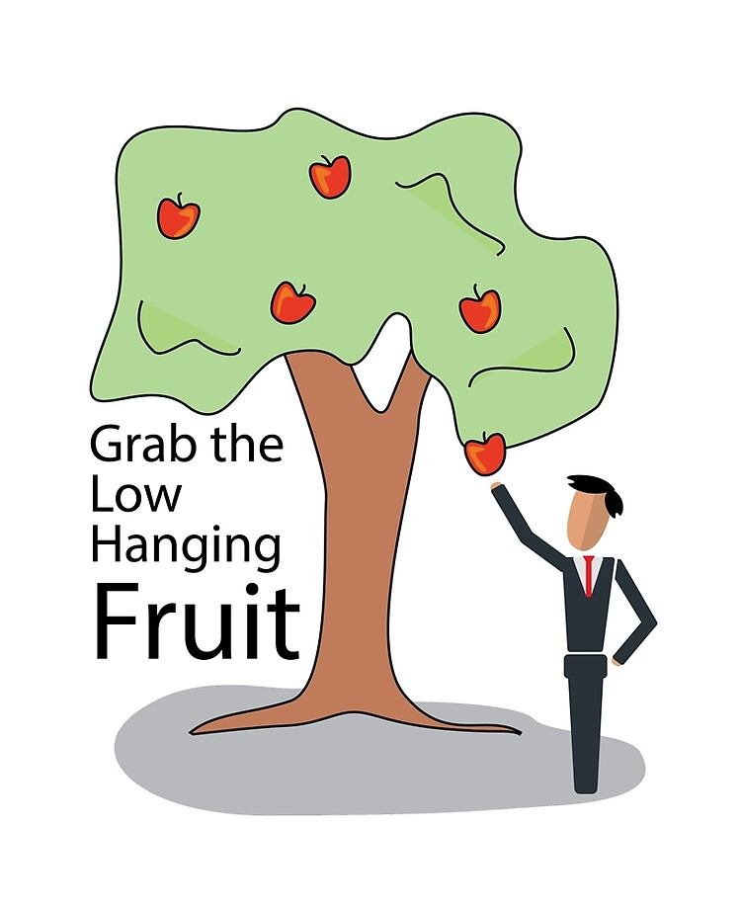

Slide 10
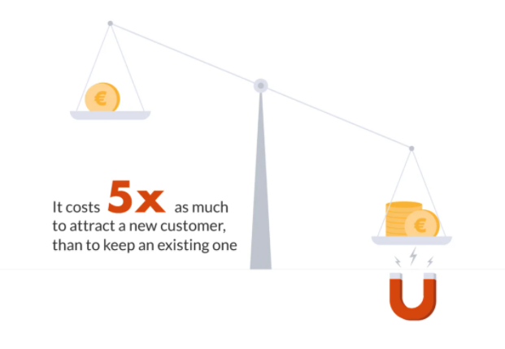
“500% is too expensive to be overcharged”

Slide 11


1/ Increased productivity (instantly) 2/ Reduce Cost (instantly) 3/ Headcount & payroll (Save$) 4/ Less call failures (save time)

Slide 12
So, it makes perfect sense that focusing on reducing churn is paramount since keeping your customers is Great for the Bottom line
Yet,many companies DO NOT understand this and, as a result, still struggle in trying to implement a successful churn prevention strategy or blindly follows only growth.
The solution to customer churn, I will pass to -> my other speakers … in a few more minutes.

Slide 13

Six-Steps
1/ Use-Case
2/ Personas
3/ Pain-Points
4/ Generate Ideas
5/ Impact v Feasibility
6/ Storyboard & Hills

Slide 14

Our Dataset is from the Public domain and the EDT process is 100% Simulated

Slide 15
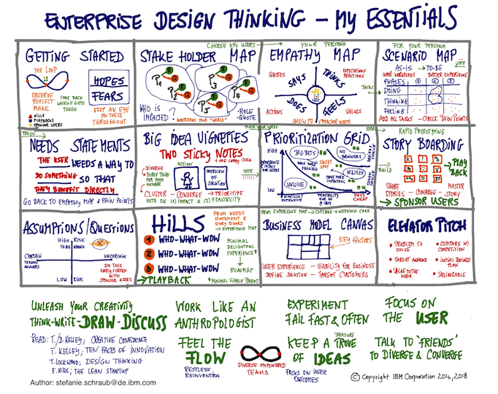

Slide 16
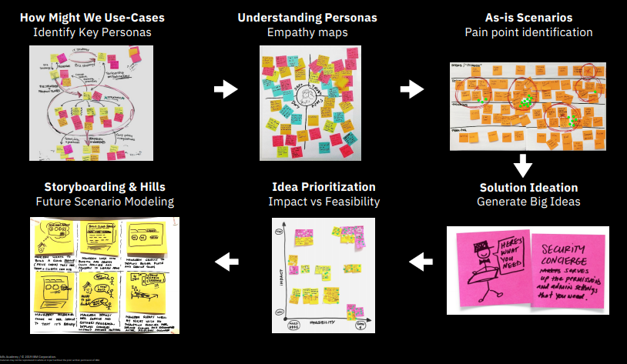

Slide 17
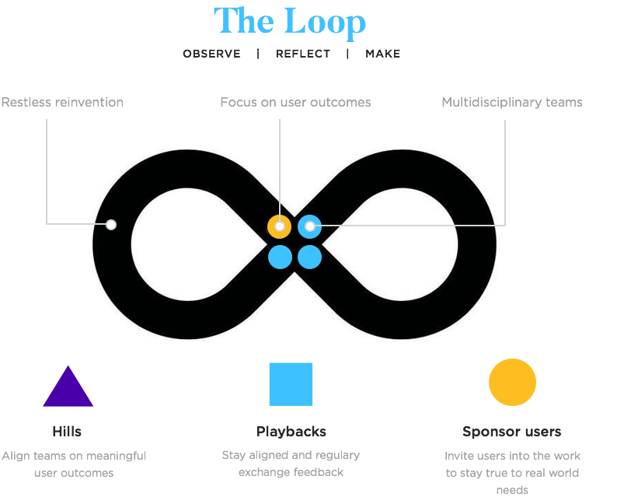
“Churn will be never ending, hence the unending Loop to keep finding more innovative solutions.”

Slide 18
How might we use case
How might Telcos Keep Customers by identifying those who will be the most loyal with the least amount of marketing cost
In other words, let us find the lowest hanging fruits to give the most bang for the buck.

Slide 19

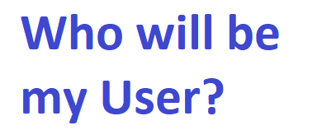

Slide 20
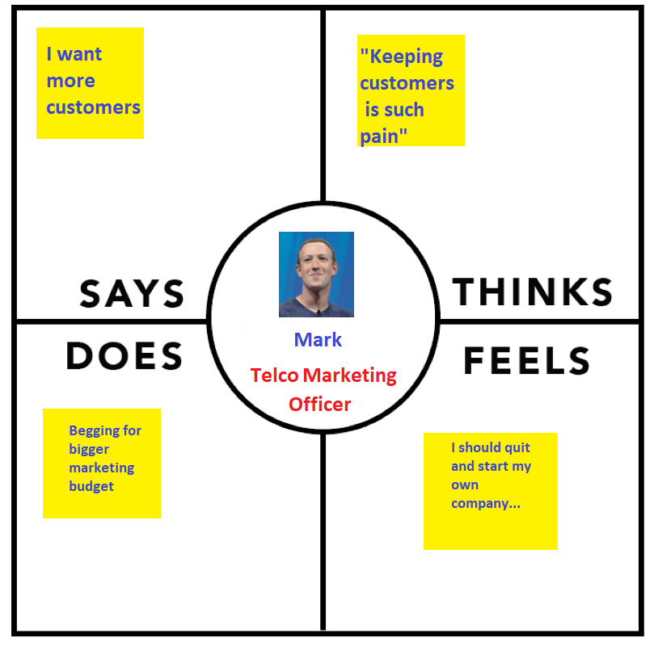
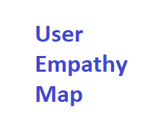

Slide 21

Pain-Points for Telcos (condensed version)
Smearing by word of mouth by the unhappy
Natural attrition of customer base
Huge cost to acquire new
Lost of wallet share (hence, revenue)
Poor social media sentiments
Aggressive competition taking away precious customer base via upset customer (Own goal) -> easy recovery if telco can just say sorry -> just need the indicators.

Slide 22


Wishlist & the Wows
increase customer base retention
reduce churn especially high, spenders
cross/upsell
predicting future consumer behaviour
classifying customers/ segmentation
Help direct social media strategy
Positive Impact of churn on referrals
WOW -> New Product feature and new Launch Strategy to overcome competition to win big.

Slide 23
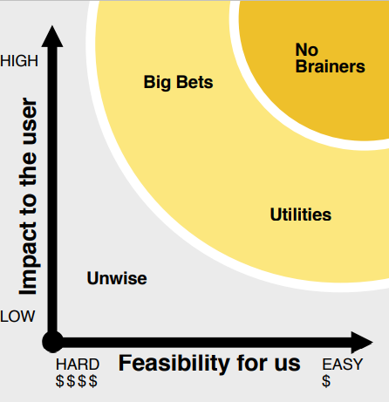
Using existing data to feed a machine learning model to find the low hanging fruits with max bang -> next speaker will dive deeper
Merge or Acquire a major competitor
Rewards points pegged to size of bills
Spending most of the marketing budget to get new customers only

Slide 24
Planning Analytics
Proposed Solution
01 - Shiji Ann Abraham - AI0403

Slide 25
Client’s Situational Assessment
Telecom industry has become very competitive with price wars and competent service levels
Mobile number portability has made switching between telco operators easy for customers
Our telco client is losing it’s post paid customers to competitors at a high rate - the current annual churn rate is 27%
This means the entire telco post paid customer base is completely churned in less than 4 years
Our client approached us to help them lower their anual post paid churn rate to 15%.

Slide 26
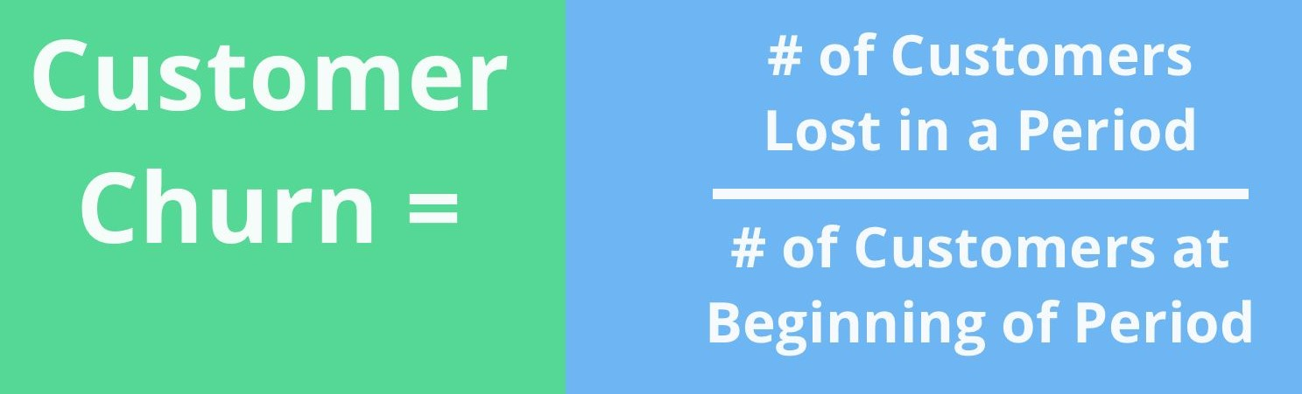
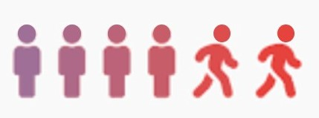
What is Customer Churn?
Reasons for telco customer churn : Pricing promotions from competitors, poor network service, lack of customer service, billing disputes, competitors introducing new products / technologies.

Slide 27

Managing Customer Churn
Different approaches to manage customer churn:
Untargeted approach
Targeted Approach
Reactive
Proactive

Slide 28
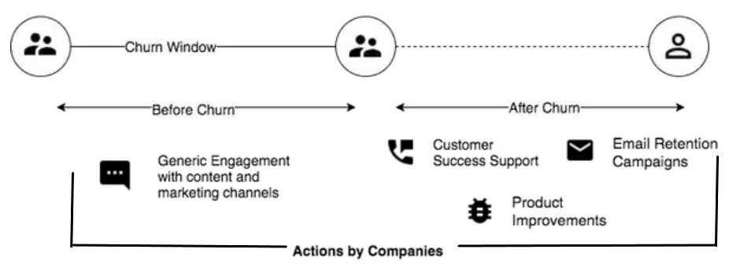
Reactive Churn Management
Customer Engagement Journey
In this approach, it is generally too late to take retention actions after a customer churns out. Success rates on retaining customers are around 2–3%.

Slide 29
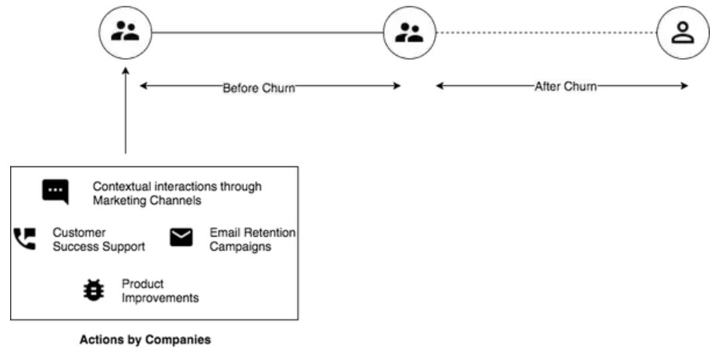
Proactive Churn Management
Customer Engagement Journey
Customer re-engagement incentives are offered before the actual churn. In this approach, the success rates of retaining customers is upto 70%.

Slide 30
Advantages of Targeted Proactive Approach:
Targeted proactive programs have an advantage of lower incentive costs.
The incentive cost in reactive approach is higher as the customer has to be bribed not to leave at the last moment.
The customer will be more open to proactive incentives as the offer is being made well in advance of the actual churn.
This leads to a much better customer experience and improved customer loyalty.

Slide 31
Target Customer Segment
Potential Voluntary Churners - Customers who have a high probability of canceling their subscription.
Post Paid Customers - We will be focusing on the Post Paid segment as the telecom client’s priority is to first control the potential revenue loss.

Slide 32
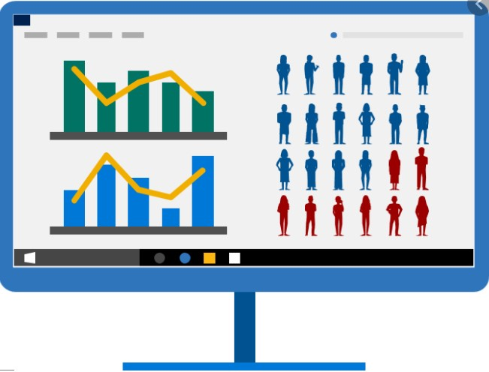
What is Churn Prediction?
Using machine learning to predict whether a customer will churn or not.
It helps to find patterns in existing data associated with the predicted churn.
This information empowers businesses with actionable intelligence to improve customer retention and profit margins.

Slide 33
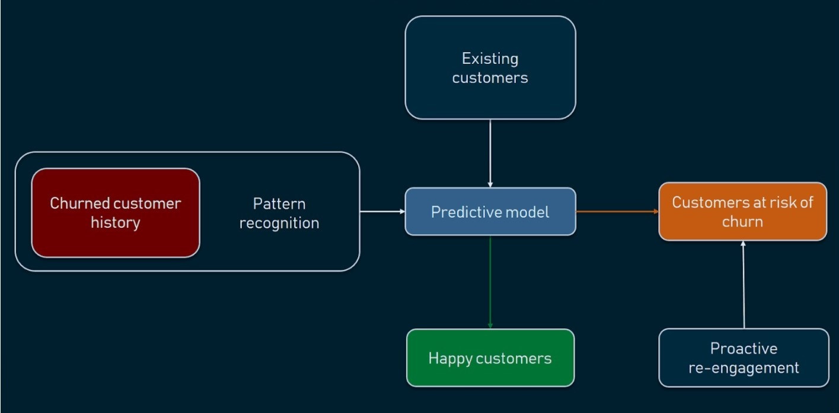
How to predict Customer Churn?

Slide 34
Highlights about the data set
From kaggle.com
Contains post paid customer data
Contains data of 7043 customers’ and has 21 columns/features.
Contains data about customer demographics, billing information and cross - product holdings.
Has key feature columns like tenure and churn that helps to explain the high churn rate.

Slide 35
Metadata of the data set
Demographic Data
Gender
Senior Citizen
Partner
Dependents
Cross-Product Holdings
Phone Service
Multi Lines
Internet Service
Online Security
Online Backup
Device Protection
Tech Support
Streaming TV
Streaming Movies
Billing Information
Contract
Paperless Billing
Payment Method
Monthly Charges
Total Charges
Others
Churn
Tenure

Slide 36
Hypothesis from the data
Customers on month-to-month contract has a higher risk of churning.
Customers who use tech support will probably churn less compared to other customers.
Customers who use Electronic check form of payment has a higher risk of churning.
Customer churn will be higher when customer tenures are lower.

Slide 37
Key Business Benefits
ARPU
Marketing Costs
Customer Loyalty
Customer Service Costs
NPS - Customer Satisfaction
Negative Social Media Sentiments
Application of Churn Prediction Score
Large Volume
Real Time
Client Context

Slide 38
Application of Churn Prediction
Personalized marketing offers based on customer behavior patterns to retain customers with high churn probability.
Location-based data for location based advertising.
Optimal Campaigns for up-sell, cross-sell and acquiring new customers based on the customer behaviour pattern.

Slide 39
Descriptive Analytics
Data Exploration & Preparation
Data Representation & Transformation
Data Visualization & Presentation
Regina Sun Wei Ling - AI0403

Slide 40

Descriptive Analytics
Actual annual churn rate 27%
Target annual churn rate 15%
WHAT happened?
Notes:
To understand WHAT happened, I will start by explorating the dataset to illuminate previously unknown patterns, relationships, or other actionable findings.

Slide 41




Descriptive Analytics
Watson Studio

Slide 42
Descriptive Analytics
PixieDust
Tables
Bar Charts
Scatter Plots
Maps
Line Charts
Histograms

Slide 43
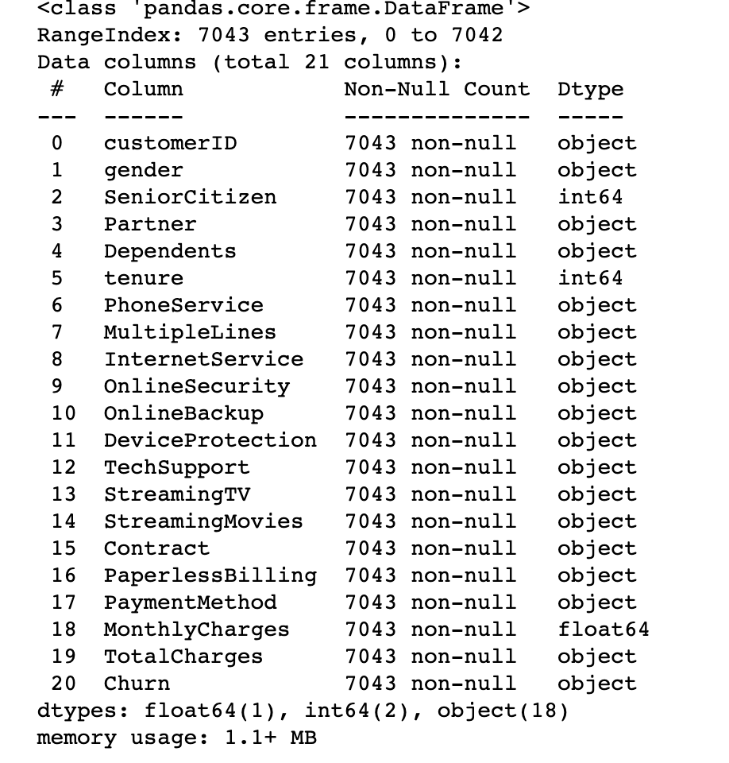
Descriptive Analytics
Data exploration and preparation

Slide 44
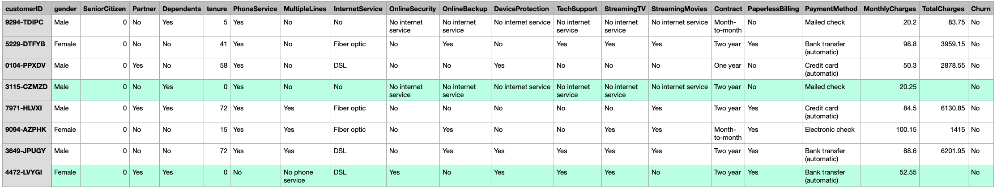
Descriptive Analytics
Data exploration and preparation

Slide 45
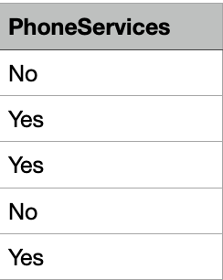
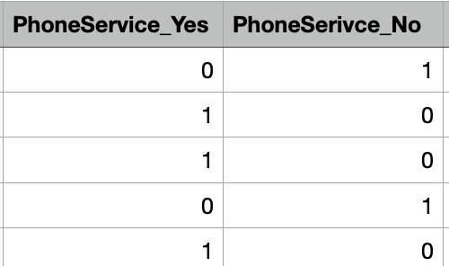
Descriptive Analytics
Data Representations & Transformation
Label Encoding
✓ One Hot Encoding

Slide 46
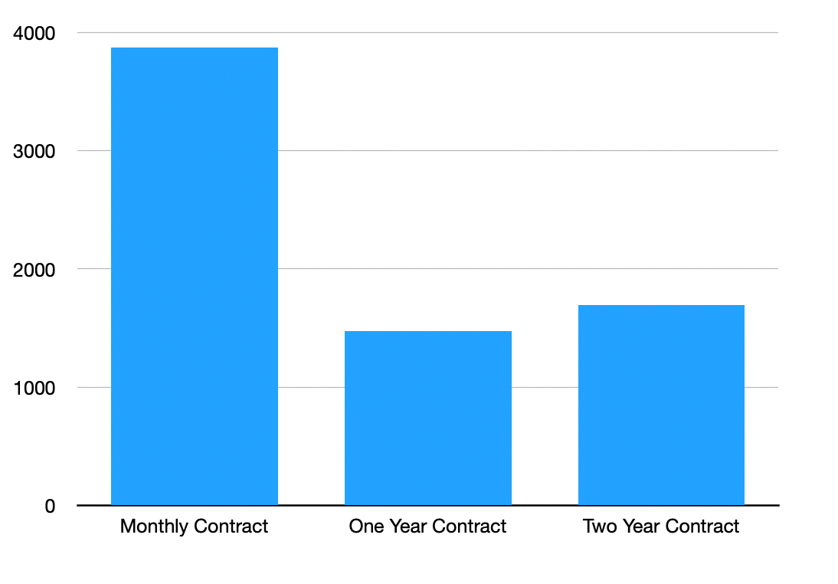
Descriptive Analytics
Data Visualization and Presentation
Monthly Contract 3875
One Year Contract 1473
Two Year Contract 1695
Number of Customer

Slide 47
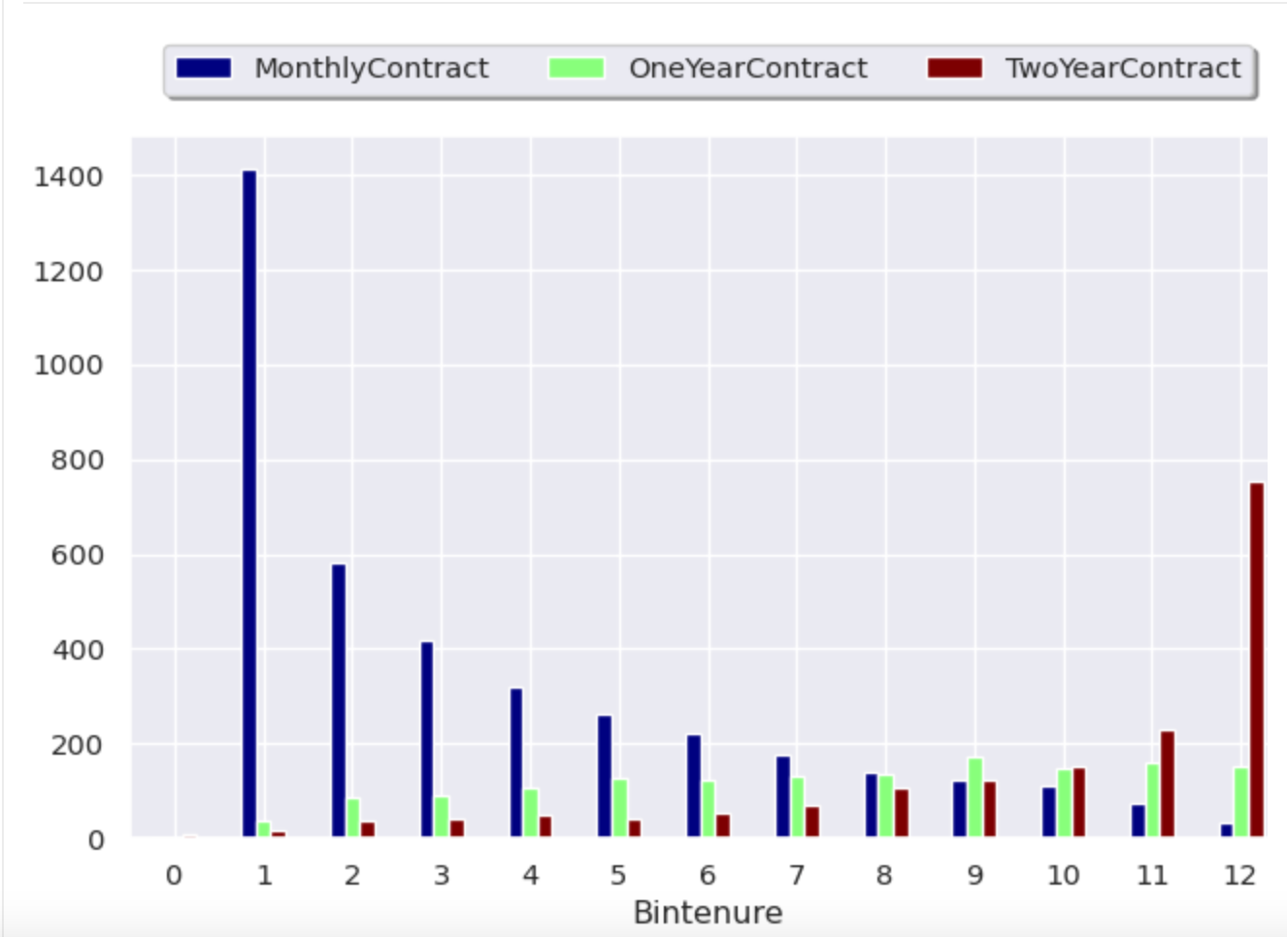
Descriptive Analytics
Data Visualization and Presentation
Monthly Contract
Monthly contract customers on shorter tenure

Slide 48
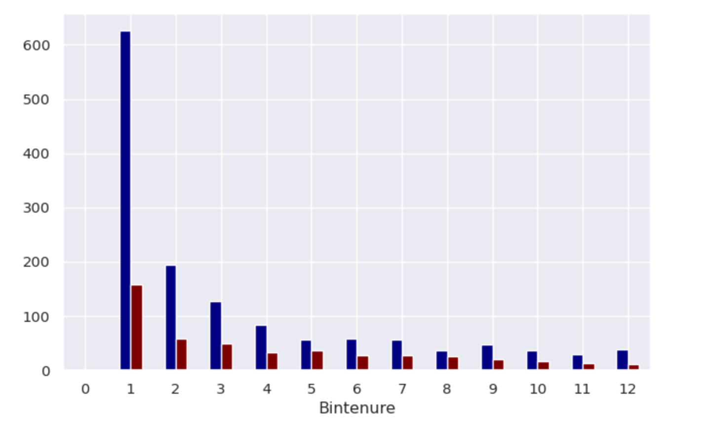
Descriptive Analytics
Data Visualization and Presentation
Customer Tenure
Non Senior Citizens
Senior Citizens
High number of non senior citizens churn at Bintenure 1
(0 - 6 months tenure)

Slide 49
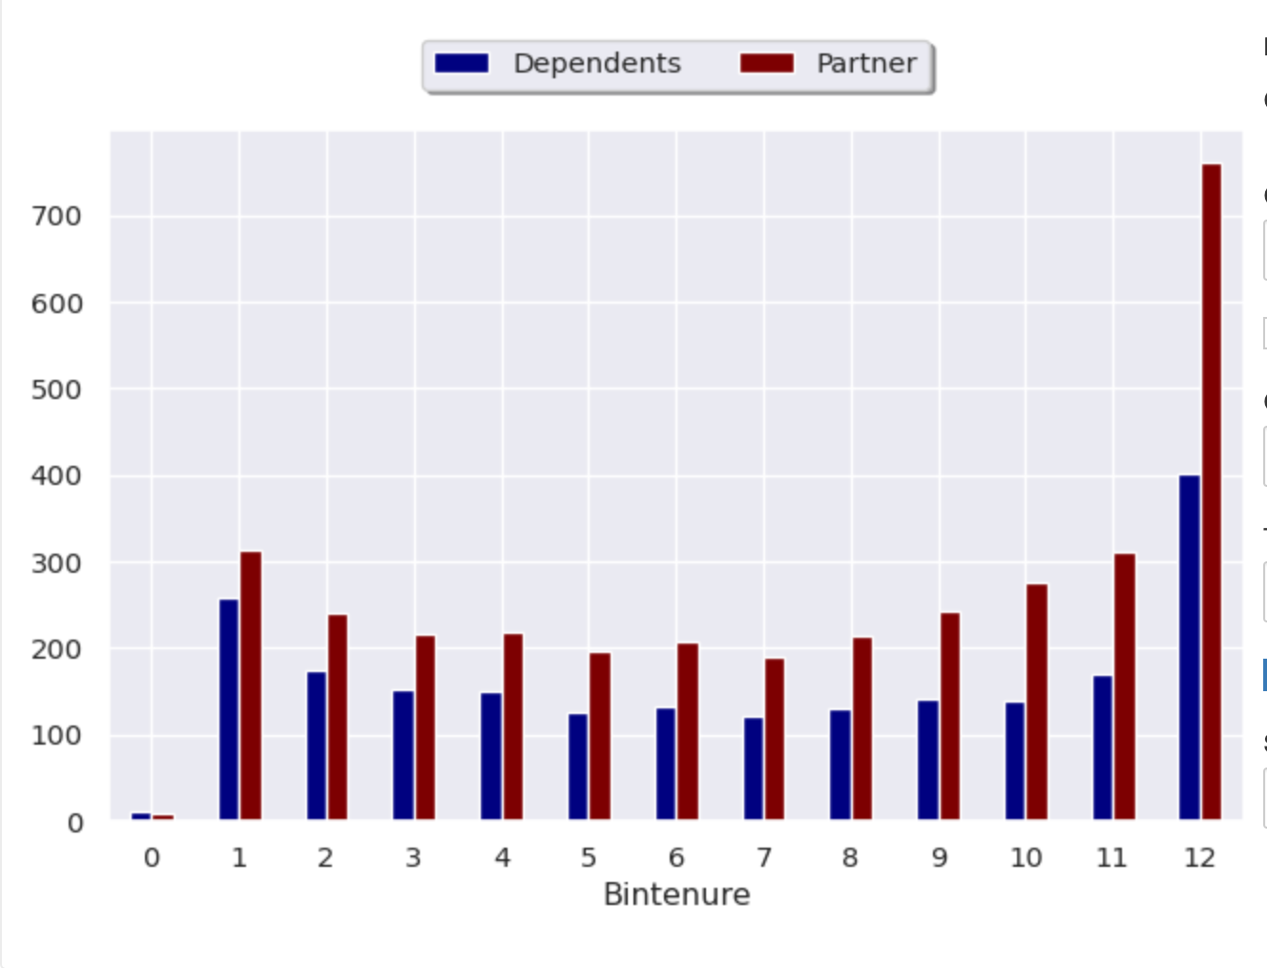
Descriptive Analytics
Data Visualization and Presentation
Customers with Dependents amd Partners have longer Tenure

Slide 50
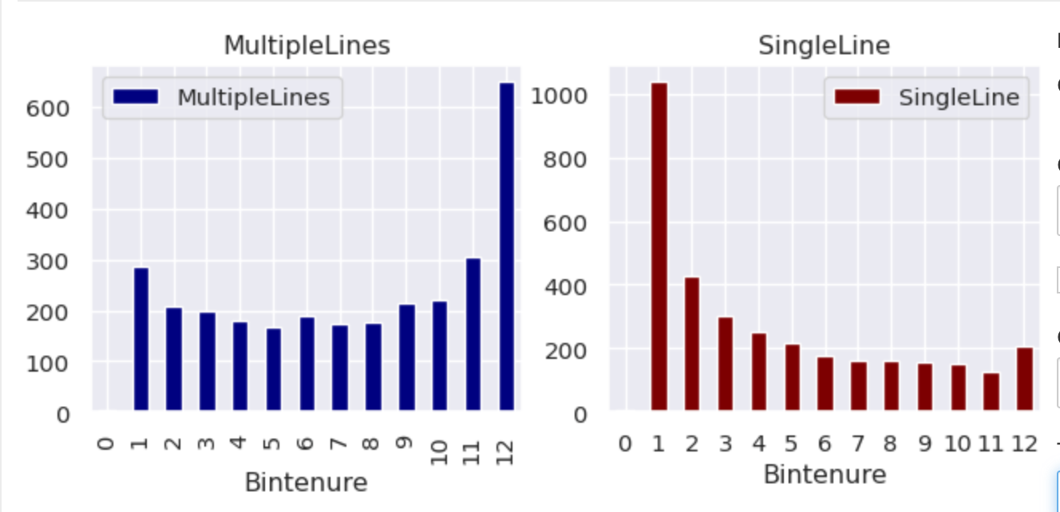
Descriptive Analytics
Data Visualization and Presentation
Customers with multiple lines have longer tenure
Customers with single line have shorter tenure

Slide 51
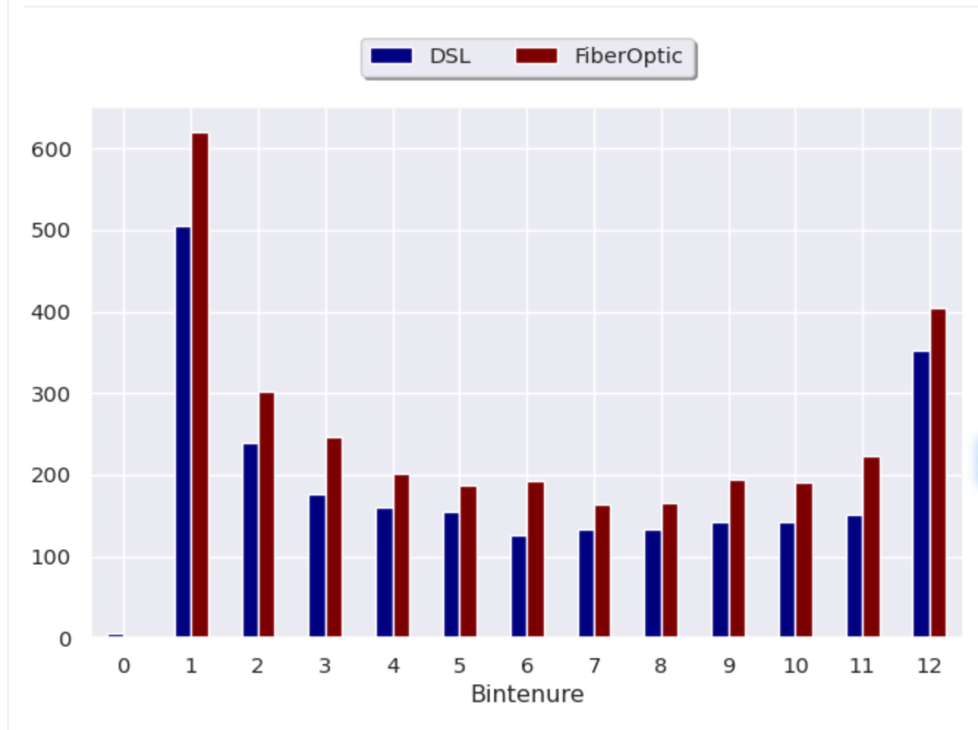
Descriptive Analytics
Data Visualization and Presentation
Customer with Internet service have short tenure

Slide 52
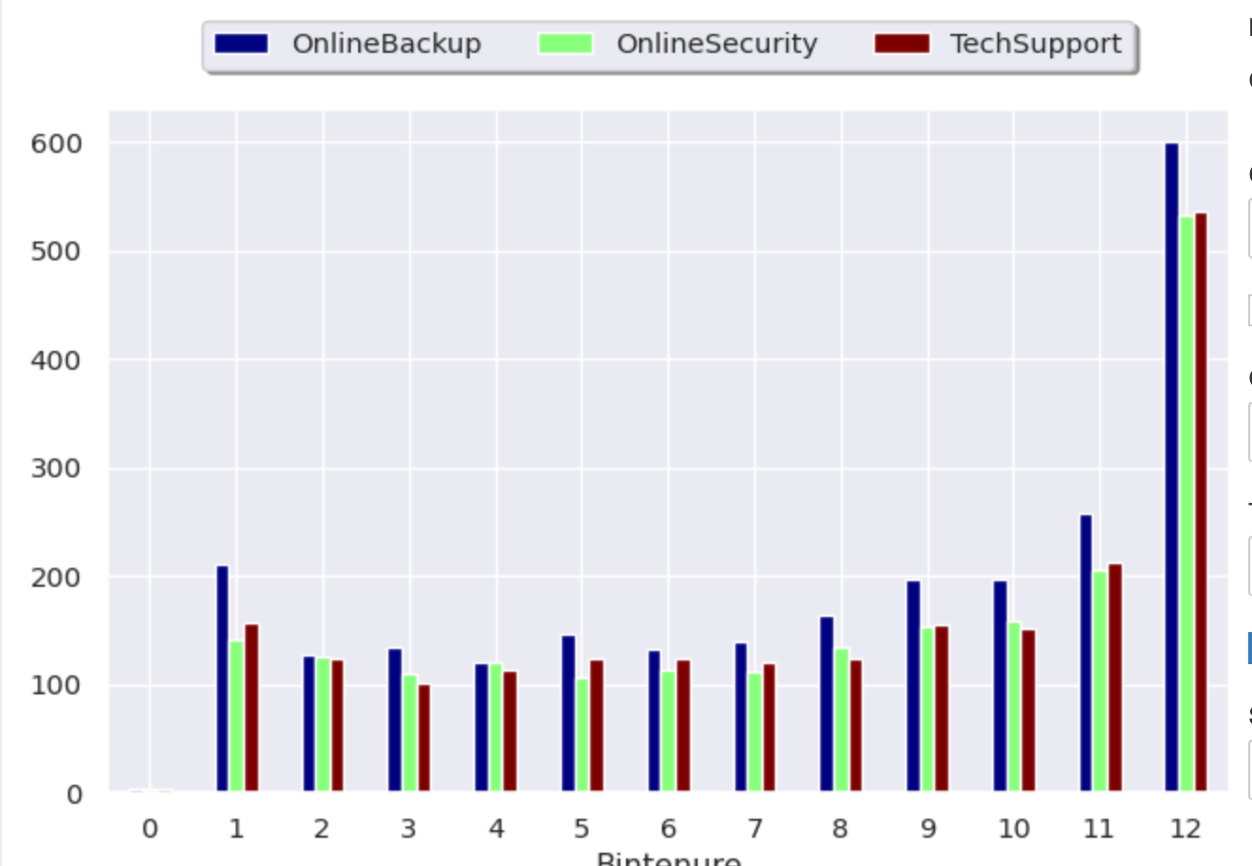
Descriptive Analytics
Data Visualization and Presentation
Customers with these services have long tenure

Slide 53
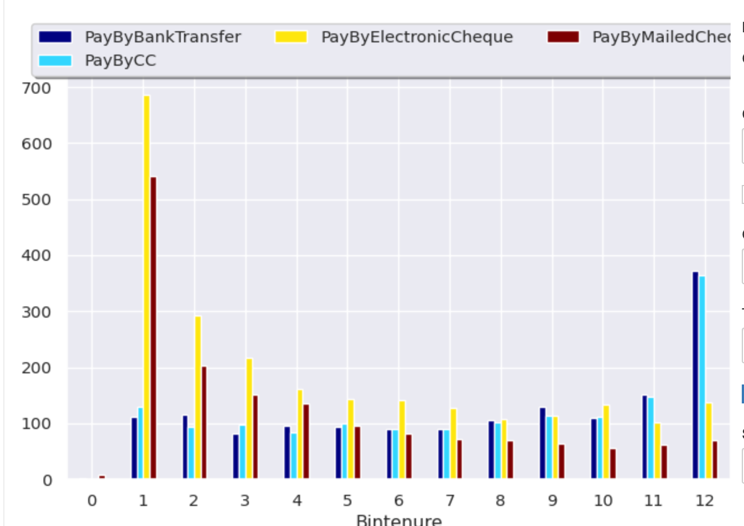
Descriptive Analytics
Data Visualization and Presentation
Billing Methods
Payment by Electronic cheque most popular for customer with short tenure
Payment by Bank transfer and Credit card customer has a longer tenure

Slide 54
Diagnostic Analytics
Data Exploration & Preparation
Data Representation & Transformation
Data Visualization & Presentation
21 - (KC) Yeo Khee Chye - AI0403

Slide 55
Diagnostic Analytics
Identify anomalies
* Actual Churn is 27% but Target Churn is 15%
Drill into the analytics (discovery)
* Identify potential drivers and data source to help explain the high churn
* Look for pattern from existing datasets
* Pull data from external sources
Determine causal relationship
* Identify causal relationships
* Determining causal relationship requires far more in-depth subject area knowledge and contextual information.
* Useful techniques includes regression analysis, time series analysis, probability theory, filtering.

Slide 56
Identify Relationships Between Features And The Target
What has been done:
Visualise relationship of each feature to the target “Churn”.
Check for difference in feature profile for “Churn” vs “No Churn”.
Determine size of difference for categorical features and rank them from “high” to “low” importance.
Check correlation of numerical and binomial features to the target “Churn”.
Features with high importance and/or correlation help us identify key features that contribute to customer churn.
Note: Correlation does not imply causation.

Slide 57
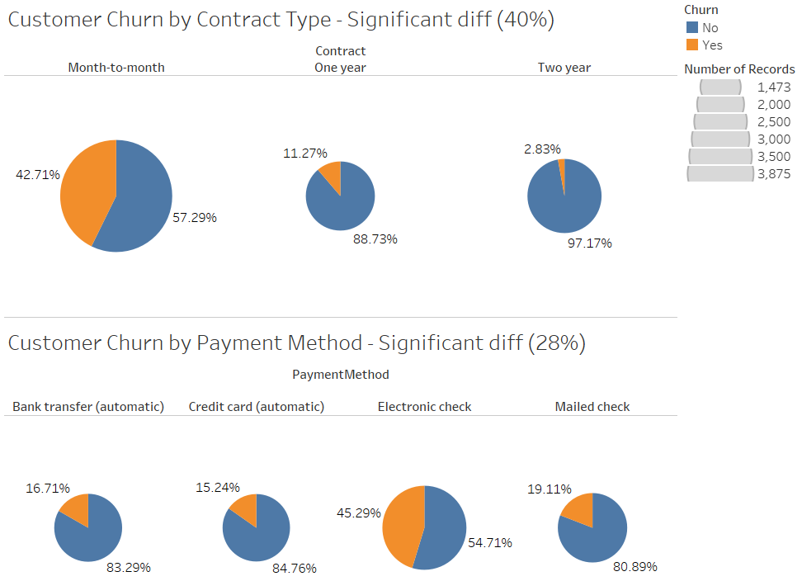
Data Exploration:
Features with High Importance
“Contract Type” show significant difference in churn rate.
Low churn rate
High churn rate
“Payment Method” show significant difference in churn rate.
Low churn rate
High churn rate

Slide 58
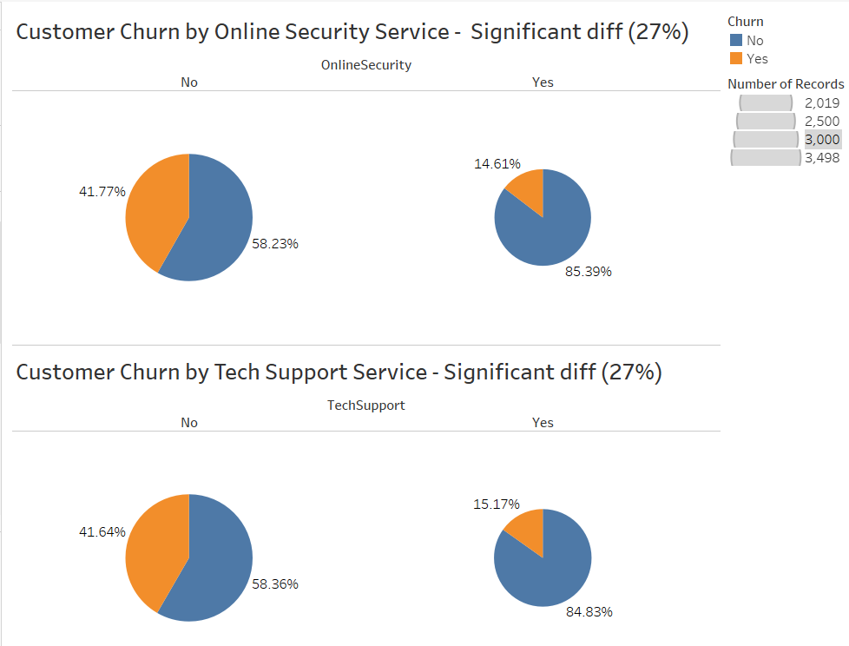
Data Exploration:
Features with High Importance
Low churn rate
High churn rate
“Online Security Service” and “Tech Support Service” show significant difference in churn rate.
Low churn rate
High churn rate

Slide 59
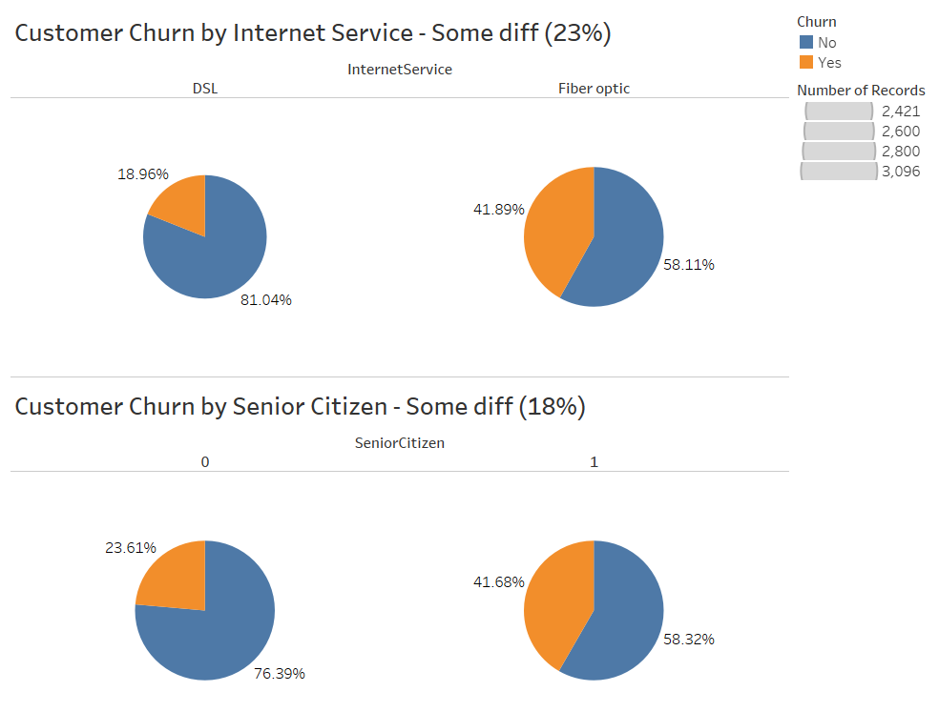
Data Exploration:
Features with Some Importance
“Internet Service” and “Senior Citizen” show some significant difference in churn rate.

Slide 60
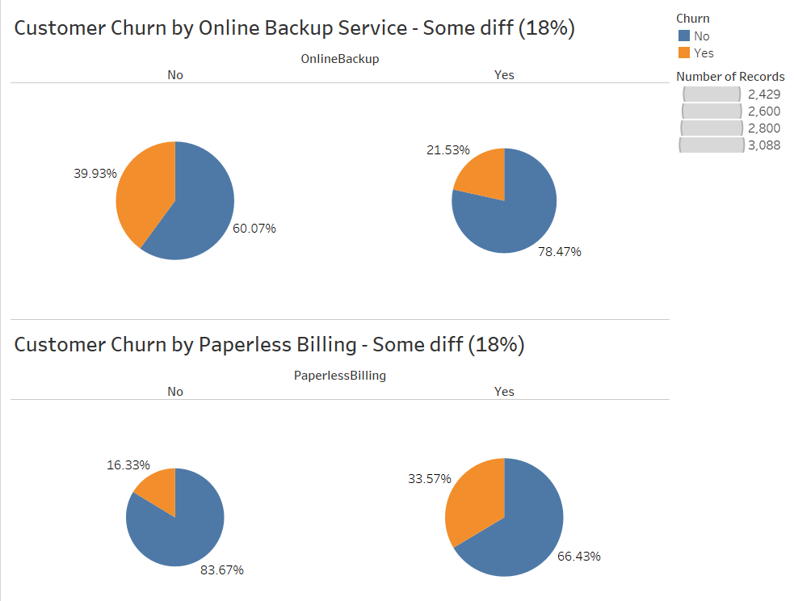
Data Exploration:
Features with Some Importance
“Online Backup Service” and “Paperless Billing” show some significant difference in churn rate.

Slide 61
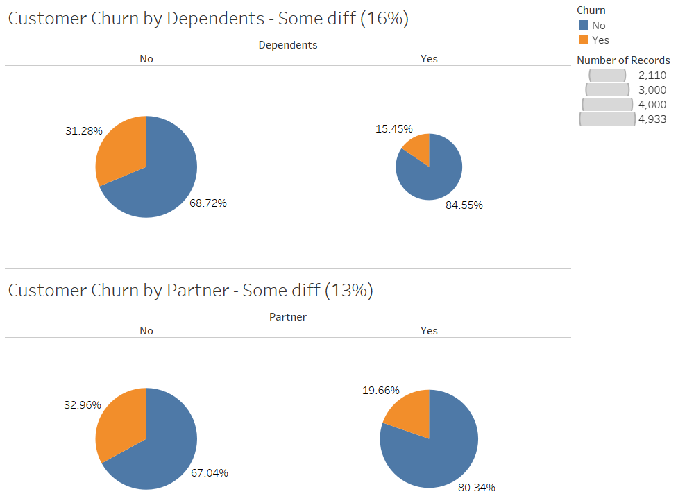
Data Exploration:
Features with Some Importance
“Dependents” and “Partner” show some significant difference in churn rate.

Slide 62
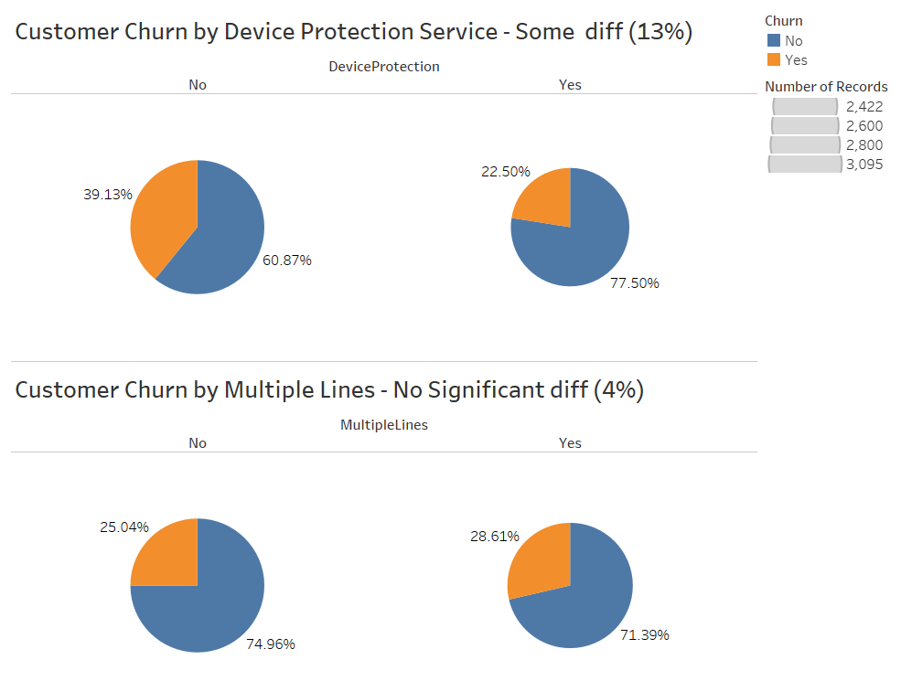
Data Exploration:
Features with Some/Low Importance
“Device Protection Services” show some difference in churn rate.
“Multiple Lines” show no significant difference in churn rate.

Slide 63
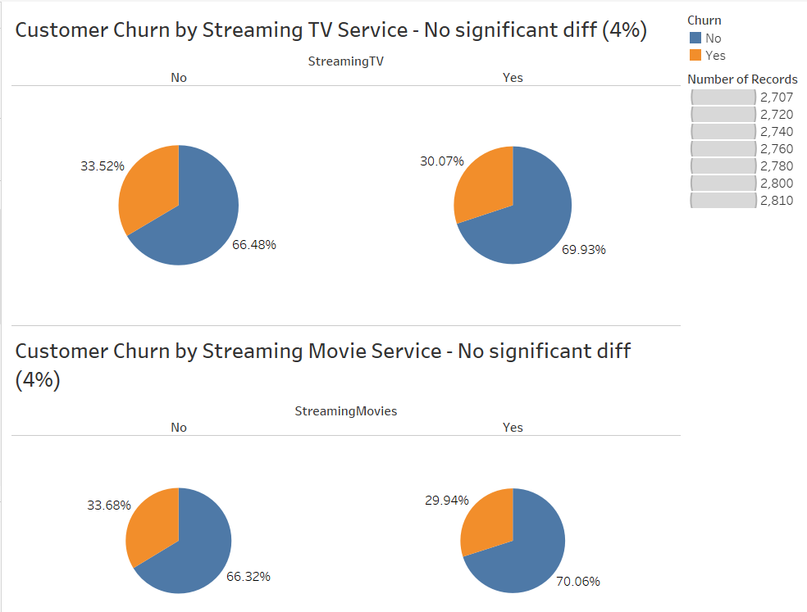
Data Exploration:
Features with Low Importance
No significant difference
“Streaming TV” and “Streaming Movie” show no significant difference in churn rate.
No significant difference

Slide 64
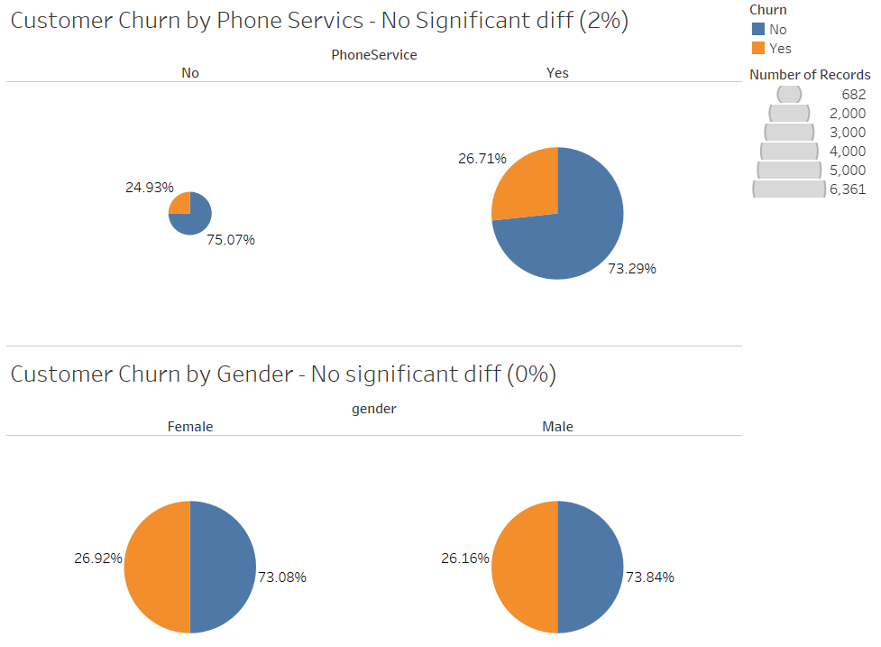
Data Exploration:
Features with Low Importance
No significant difference
“Phone Services” show no significant difference in churn rate.
“Gender” show no significant difference in churn rate.
No significant difference

Slide 65
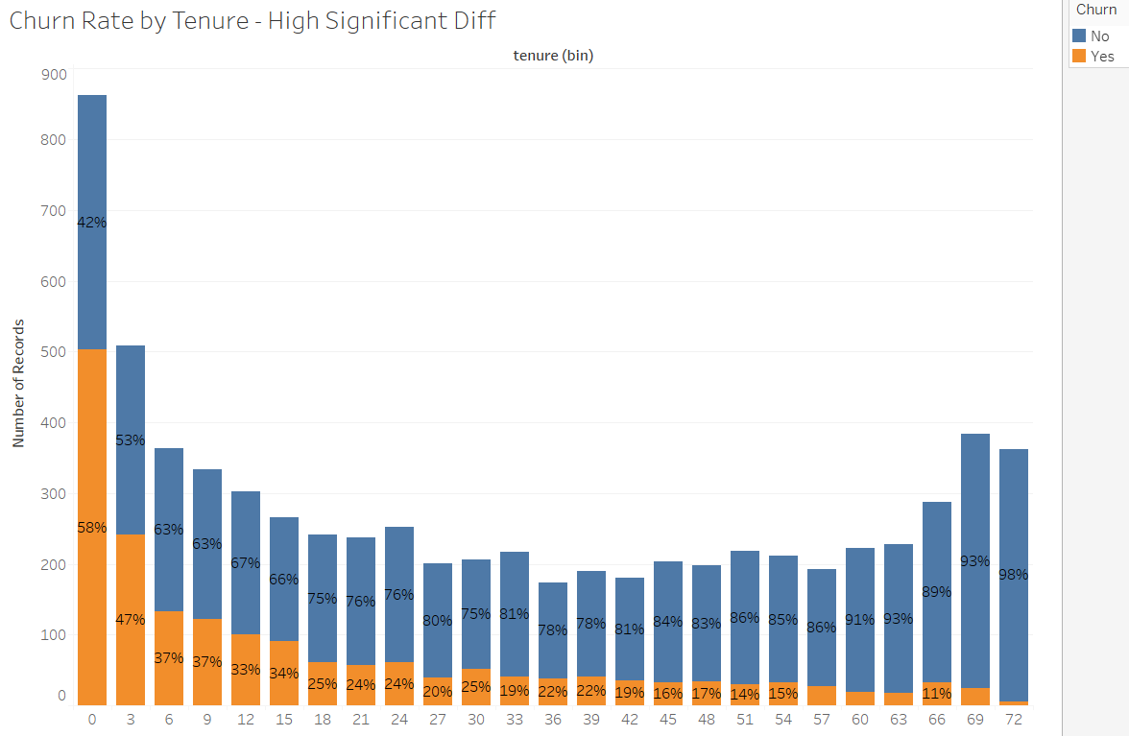
Data Exploration:
Numerical Features with High Importance
“Tenure” duration shows significant difference in churn rate.
Note: Churn rate decreases as tenure increases.
Customer churn

Slide 66
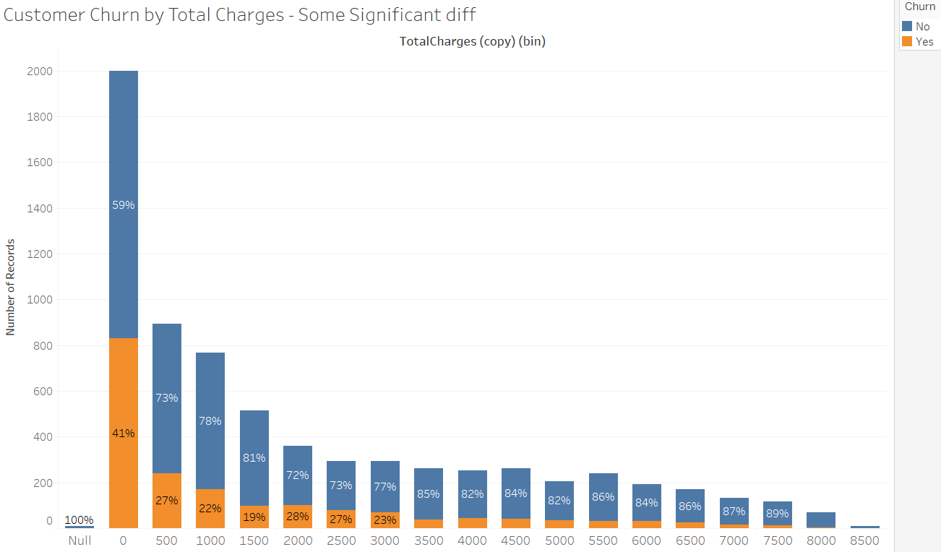
Data Exploration:
Numerical Features with Some Importance
“Total Charge” show some significant difference in churn rate.
The pattern is similar to “Tenure”.
Customer churn

Slide 67
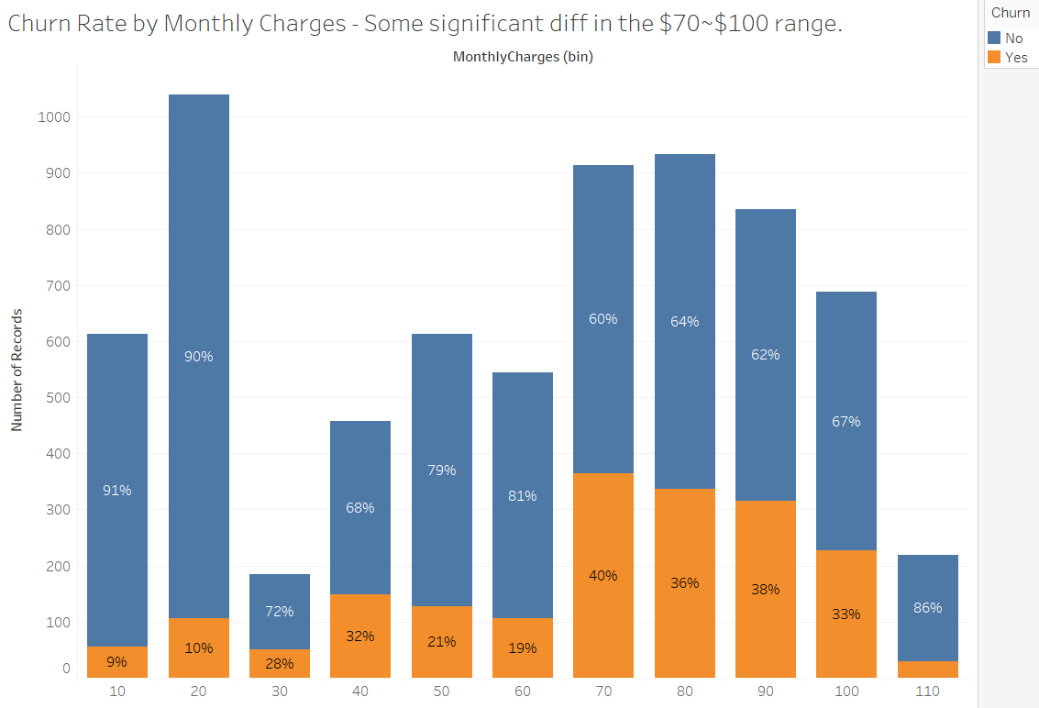
Data Exploration:
Numerical Features with Some Importance
“Monthly Charge” show some significant difference in churn rate for monthly charges between $70 to $100.

Slide 68
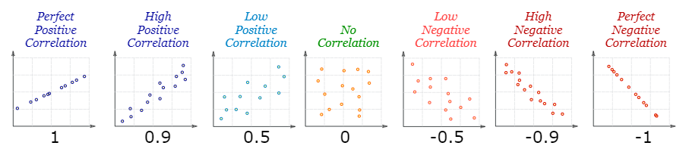
Correlation Among Variables
Correlation is a statistical measure that expresses the extent to which 2 variables are related. When 2 variables are strongly linked they have High Correlation.
There are correlation measures for linear and non-linear relationships. The most common being Pearson correlation coefficient ‘r’ which is sensitive only to linear relationship. It ranges from +1 to -1.
In above example, the ‘r’ numerical value shows how strong the correlation is, and if it is positive or negative.
Correlation is Positive when the values increase together, and
Correlation is Negative when one value decreases as the other increases
Limitations: Correlation cannot look at the presence or effect of other variables outside the 2 variables being explored. It does not tell us cause and effect.

Slide 69
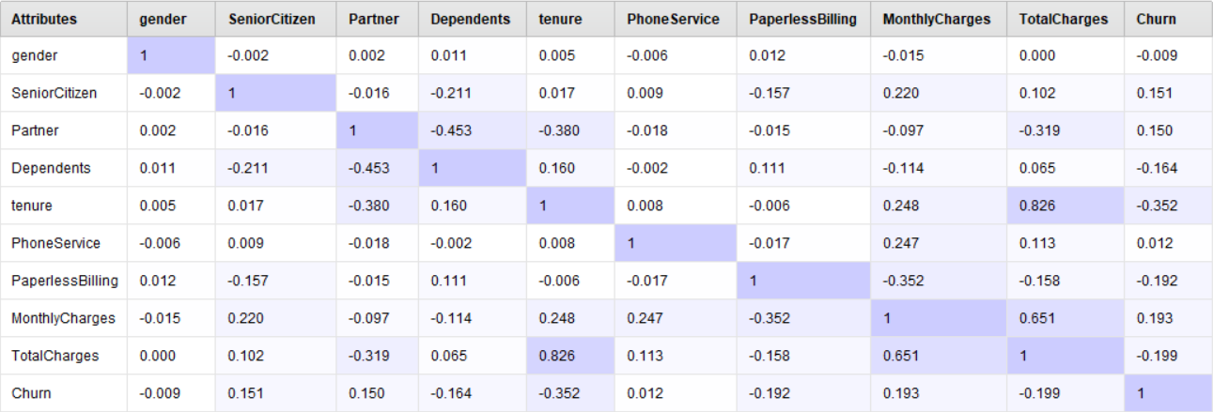
Data Exploration:
Correlation of Features To Target
Features with no or negligible correlation to Target: Gender, Phone Service. Drop no/negligible correlation features from model.
Features with very weak or weak correlation to Target: Tenure, Total Charges, Monthly Charges, Paperless Billing, Dependents, Senior Citizen, Partner.

Slide 70
Diagnostic Summary: Feature Importance
Important Features
Contract Type
Payment Method
Tenure
Total Charges
Not Important Features
Gender
Phone Services

Slide 71
Diagnostic Summary: Churn Customer Profile
Profile | Value | Churn Customers | Non-Churn Customers | Remarks
Contract Type | Month-to-Month | 89% | 43%
Payment Type | Electronic Check | 57% | 25%
Tenure | < 1 year | 53% | 21%
Services | Internet Service | 94% | 73%
 | Phone Service | 91% | 90% | No significant difference between churn vs no-churn customers.
 | TV / Movie Streaming | 54% | 50%
 | Security, Backup, Protection, Tech Support | 24% | 48%
Demographic | No Dependent | 83% | 66%
 | No Partner | 64% | 47%

Slide 72
Diagnostic Analytics:
Hypothesis For Statistical Testing
Customers on month-to-month contract are more likely to churn.
Customers with shorter tenure are more likely to churn.
Customers on electronic check payment method are more likely to churn.
Customers who do not subscribe to online security service are more likely to churn.
Customers who do not subscribe to technical support service are more likely to churn.
Customers who subscribe to fiber optics internet service are more likely to churn.
Customers in $70 to $100 monthly spending range are more likely to churn.

Slide 73
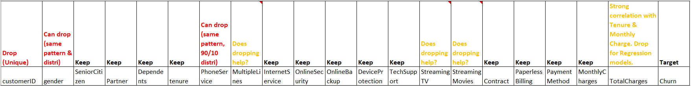
Feature Selection And Data Transformation
Data Sets | Features
Imbalance Data (27% / 73%) | Drop 3 Features: CustID, Gender, PhoneSvc. Create Tenure bins. Monthly Charge bins and Total Charge bins.
 | Drop 7 Features: CustID, Gender, PhoneSvc, Multiple Lines, Streaming TV, Streaming Movies, Total Charges. Create Tenure bins. Monthly Charge bins.
Balanced Data (40% / 60%) | Drop 3 Features: CustID, Gender, PhoneSvc. Create Tenure bins. Monthly Charge bins, Total Charge bins.
 | Drop 7 Features: CustID, Gender, PhoneSvc, Multiple Lines, Streaming TV, Streaming Movies, Total Charges. Create Tenure bins. Monthly Charge bins.

Slide 74
Data Transformation
Binning
What is binning
Grouping continuous numerical values into a smaller number of categorical “bins”.
For Telco Dataset, we created bins for
Tenure, Monthly Charges and Total Charges
Reason: May help improve predictive performance of model by reducing noise in dataset.
Pros and cons of binning continuous variable for machine learning.

Slide 75
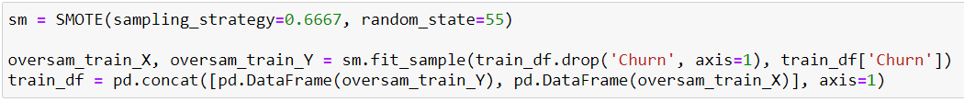
Data Transformation
Handling Imbalanced Dataset
Problems with Imbalanced Dataset
Can result in models that have poor predictive performance for the minority class.
Different ways of handling imbalanced dataset. E.g.
Collect more data
Use cost-sensitive learning algorithms
Undersampling (Reduce size of majority class).
Oversampling (Increase size of minority class).
Use combination of various ways.
For Telco Dataset, we oversample with SMOTE (Synthetic Minority Over-Sampling Technique)
Reason: Not to lose more information via undersampling as dataset is not large.
SMOTE creates new synthetic instances from the minority class.
Increased the minority class proportion from 27% to 40%.

Slide 76
Augmenting Diagnostics Analytics
With Machine Learning
Above diagnostics were performed manually.
Manual efforts become increasing non-viable as data volume, variety and velocity increase.
A more effective way in answering why something happen is to combine AI-infused software with domain expertise of people.
Now, we move to answering the question: What will happen next?

Slide 77
Predictive Analytics &
Prescriptive Analytics
Train Data Model
Validate Data Model
Deploy Data Model
07 - Ivy Tan Sor Tin - AI0403

Slide 78

Predictive Analytics
Predictive analytics are used to determine customer responses or purchases, as well as promote cross-sell opportunities. Predictive models help businesses attract, retain and grow their most profitable customers. Improving operations. Many companies use predictive models to forecast inventory and manage resources.
In Short:- We are looking at WHAT HAPPENS NEXT?

Slide 79

Three Main steps of Data Modelling
Building a model is an iterative process.
Most Models consist of the following main steps:-
Selection of a modeling technique and variables to enter in the model
Execution of the model
Diagnosis and model comparison

Slide 80


Studio
Watson Studio has a Auto AI option which is very FRIENDLY and EASY to use. Once you input the Data Set into the option and select the target variable that you would like to predict, it will AUTOMATICALLY generate the select the models for you. When the models are completed it even advise you the BEST OPTIMAL MODEL you should used.
SAVE TIME and EFFORT for Data Analyst & Data Science to QUICKLY get insights of the DATA.

Slide 81

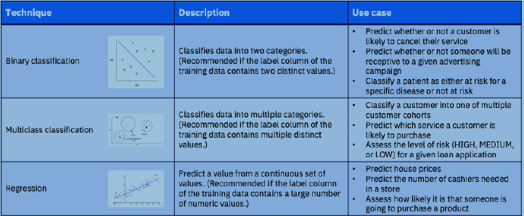
Machine Learning Techniques Used in Watson Studio

Slide 82
Watson AutoAI has 4 processes
Studio
1. Data pre-processing
2. Automated model selection
3. Automated feature engineering
4. Hyperparameter optimization

Slide 83
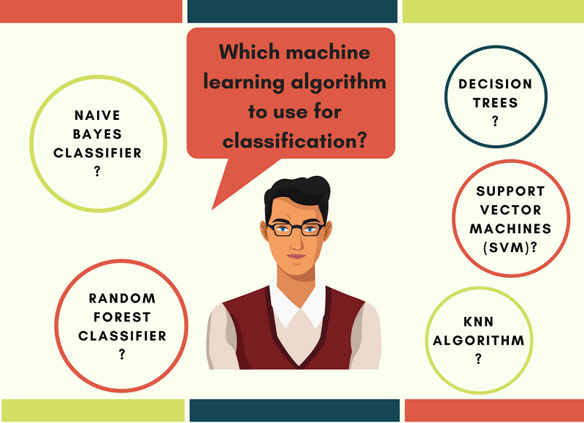
Available Classifiers in Watson Studio
Binary and MultiClass Classification:-
Decision Tree Classifier
Extra Trees Classifier
Gradient Boosting Classifier
LGBM Classifier
Logistic Regression
Random Forest Classifier
XGB Classifier
Regression Classification:-
Decision Tree Regressor
Extra Trees Regressor
Gradient Boosting Regressor
LGBM Regressor
Linear Regressor
Random Forest Regressor
Ridge
XGB Regressor

Slide 84
More Model Setting in Watson Studio:-
Training Data Split : 90% Testdata: 10% Changed: 85 to 95
Remove Duplicate Row: On (Default)
SubSample Row: Off (Default)
Training Data Split : 90% - 3 folds cross-validation (Fixed) Holdout : 10%
Use Binary Classification - Churn (TARGET) Include/Exclude Fields
Optimised Runtime: Accuracy/F1 scores/ROC/Precision/Recall

Slide 85
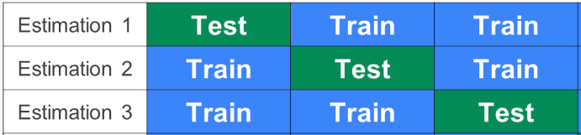
3-Fold Cross-validation In Telco
7,043 Rows
BENEFIT:
Maximize the usage of LIMITED DATASET
2,348 Rows

Slide 86

Model Evaluation Metrics
Confusion Matrix for Telco
True Positives (TP) - These are the correctly predicted positive values which means that the value of actual class is yes and the value of predicted class is also yes. E.g. if actual class value indicates that this passenger survived and predicted class tells you the same thing.
True Negatives (TN) - These are the correctly predicted negative values which means that the value of actual class is no and value of predicted class is also no. E.g. if actual class says this passenger did not survive and predicted class tells you the same thing.
False positives and false negatives, these values occur when your actual class contradicts with the predicted class.
False Positives (FP) – When actual class is no and predicted class is yes. E.g. if actual class says this passenger did not survive but predicted class tells you that this passenger will survive.
False Negatives (FN) – When actual class is yes but predicted class in no. E.g. if actual class value indicates that this passenger survived and predicted class tells you that passenger will die.

Slide 87


Model Evaluation Metrics
Accuracy - Accuracy is the most intuitive performance measure and it is simply a ratio of correctly predicted observation to the total observations.
Accuracy = TP+TN/TP+FP+FN+TN
Precision - Precision is the ratio of correctly predicted positive observations to the total predicted positive observations.
Precision = TP/TP+FP
Recall (Sensitivity) - Recall is the ratio of correctly predicted positive observations to the all observations in actual class - yes.
Recall = TP/TP+FN

Slide 88
Model Evaluation Metrics
F1 score - F1 Score is the weighted average of Precision and Recall. Therefore, this score takes both false positives and false negatives into account. Intuitively it is not as easy to understand as accuracy, but F1 is usually more useful than accuracy, especially if you have an uneven class distribution.
F1 Score = 2*(Recall * Precision) / (Recall + Precision)
AUC - The Area under the curve (AUC) is the measurement of the ability of a classifier to distinguish between classes and is used as a summary of the ROC curve. The higher the AUC, the better the performance of the model at distingushing between the positive and negative classes.

Slide 89

Relationship Map In Watson Studio

Slide 90

Pipeline leaderboard In Watson Studio

Slide 91

Model Evaluation Metrics In Watson Studio

Slide 92


Model Evaluation Metrics In Watson Studio
Recall
Accuracy
Precision

Slide 93


Model Evaluation Metrics In Watson Studio

Slide 94

Model Evaluation Metrics In Watson Studio

Slide 95

Modelling Evaluation with ImBalance Data VS Raw Data Set

Slide 96

Modelling Evaluation with Balanced Data Vs Raw Data
** BEST MODEL**

Slide 97


Deployment In Cloud

Slide 98
Predictive Analytics
16 - Wee Chi Yu - AI0403
Hyper Parameter Optimization (XGBoost Classifier)
Notes:
Thank you Ivy for walking through the Watson Studio process. Indeed Watson Studio is a great help for a non-coder to train, learn and deployed the model with all the graphical user interface and automation. It is a great example of a “no-code” tool that is intuitive and effective. While appreciating the functionality of Watson studio, the team also felt that we should also peek under the hood of the engines to further enhance what we have learned in our Data Science module.

Slide 99
Predictive Analytics (XGBoost Default)
We are using XGBoost to run the classification.
Use cross validation and tune the hyperparameters to get the a optimum model.
Plot, Confusion Matrix, precision recall curve, ROC curve & Feature Importance for easy visualization.
XGBOOST Classifier (Default) (Benchmark)
XGBOOST Classifier
(Tuning Parameters) (Grid Search)
XGBOOST Classifier
(New Parameters)
Balanced
Dataset (Telco)
Other Classifiers
(2)
(3)
(4)
(5)
Hyperparameter Optimization Process (3) & (4)
Notes:
I will briefly walk through the Hyper parameter Optimization process with a simple practical visualization
We are using XG Boost to run the classification. - Use cross validation and tune the hyper parameters to get an optimum model. - Plot, Confusion Matrix, precision recall curve, ROC curve & Feature Importance for easy visualization. In summary,
We will feed in the balanced Telco dataset in Box #1 Run thru the model in XG Boost Classifier using the default setting in Box #2 to set the Training benchmark. Using Grid Search method to tune the selected hyper parameters for optimum setting in Box #3. Run thru the model in XG Boost Classifier using the new setting in Box #4 for a better Test Score results. And lastly try using other Classifiers as in Box #5

Slide 100
Predictive Analytics (XGBoost Default)
Set the Benchmark for the training (BOX 1 & 2) Dataset is split into - 90% as training data to train the model - 10% as holding data to test the model after its training.
XGBOOST Classifier (Default) (Benchmark)
Balanced
Dataset (Telco)
(2)
(3)
(4)
(5)
#define target column for both test and train dataset train_X, train_Y = train_df.iloc[:,1:],train_df.iloc[:,0] test_X, test_Y = test_df.iloc[:,1:],test_df.iloc[:,0]
We have train_x, train_y as the training set and using test_x, test_y to evaluate the performance to set the training benchmark.
Notes:
In order to evaluate the performance of our model, we split our existing dataset into 90% as training data to train our model and keep the rest as holding data, to test our model later after its training. From the coding perspective, we have train_x, train_y as the training set and using test_x, test_y to evaluate the performance so to set the training benchmark.

Slide 101
Predictive Analytics (XGBoost Default)
Run the XGBoost Classifier (Box 2)
XGBOOST Classifier (Default) (Benchmark)
Balanced
Dataset (Telco)
(2)
(3)
(4)
(5)
#selecting the model, parameters used for the first run is to suppress error messages model1 = xgb.XGBClassifier(use_label_encoder=False, verbosity=0) #fitting the model to the training dataset model1.fit(train_X, train_Y)
XGBClassifier(base_score=0.5, booster='gbtree', colsample_bylevel=1, colsample_bynode=1, colsample_bytree=1, gamma=0, gpu_id=-1, importance_type='gain', interaction_constraints='', learning_rate=0.300000012, max_delta_step=0, max_depth=6, min_child_weight=1, missing=nan, monotone_constraints='()' n_estimators=100, n_jobs=12, num_parallel_tree=1, random_state=0, reg_alpha=0, reg_lambda=1, scale_pos_weight=1, subsample=1, tree_method='exact', use_label_encoder=False validate_parameters=1, verbosity=0)
Notes:
We run the XG Boost classifier to set the training benchmark with the emphasis on the best ROC AUC score.

Slide 102
Predictive Analytics (XGBoost Default)
XGB Classifier (default setting) Run Result.
assess_model(model1,test_X,test_Y,3)
Model: XGBClassifier(base_score=0.5, booster='gbtree', colsample_bylevel=1, colsample_bynode=1, colsample_bytree=1, gamma=0, gpu_id=-1, importance_type='gain', interaction_constraints='', learning_rate=0.300000012, max_delta_step=0, max_depth=6, min_child_weight=1, missing=nan, monotone_constraints='()', n_estimators=100, n_jobs=12, num_parallel_tree=1, random_state=0, reg_alpha=0, reg_lambda=1, scale_pos_weight=1, subsample=1, tree_method='exact', use_label_encoder=False, validate_parameters=1, verbosity=0)
3 Folds Cross Validation ROC AUC Scores: [0.79356795 0.78508403 0.79735963] Mean ROC AUC score: 0.792 (+/-0.004)
Test Set score: Accuracy: 73.90 ROC AUC=0.818 F1=0.615
XGBOOST Classifier (Default) (Benchmark)
(2)
3 Folds Cross Validation ROC AUC: [0.79356795 0.78508403 0.79735963] Mean ROC AUC Score: 0.792 (+/- 0.004)
Test Set Score:
Accuracy of 73.90, ROC AUC = 0.818 F1=0.615.
Notes:
The XG Boost result with default parameters setting is as shown.
The 3 folds Cross Validation, ROC AUC mean Scores is: 0.792
Our Test score achieved an accuracy of 73.90 and ROC AUC at 0.818 with F1=0.615.

Slide 103



Predictive Analytics (XGBoost Default)
XGBooster in default parameters
3 Folds Cross Validation ROC AUC Scores: [0.79356795 0.78508403 0.79735963] Mean ROC AUC score: 0.792 (+/-0.004) Test Set score: Accuracy: 73.90 ROC AUC=0.818 F1=0.615
Feature importance.
Bintenure, BinTotalCharge & BinMonthlyCharge are significant features
that affect the result.
Confusion Matrix
374 True Negative (ie No Churn) 144 False Positive. 147 True Positive (ie Churn) 40 False Negative.
ROC AUC achieved is 0.818 which is relatively good result.
The F1 score is at 0.615.
Notes:
From the Confusion Matrix We can see there are 374 True Negative (meaning, No Churn) and a 144 False Positive We have 147 True Positive (meaning, Churn) but with 40 False Negative The ROC AUC achieved is 0.818 which is a relatively good result. The F1 score is at 0.615. From the Feature importance. Bin tenture, Bin TotalCharge & Bin MonthlyCharge are significant features that affect the result. (Over fitting and human logical deduction) The overall result can be better by tuning some of the parameters in next test run.

Slide 104
Predictive Analytics (XGBoost Default)
XGB Classifier (default parameters)
Model: XGBClassifier (base_score=0.5, booster='gbtree', colsample_bylevel=1, colsample_bynode=1, colsample_bytree=1, gamma=0, gpu_id=-1, importance_type='gain', interaction_constraints='', learning_rate=0.300000012, max_delta_step=0, max_depth=6, min_child_weight=1, missing=nan, monotone_constraints='()', n_estimators=100, n_jobs=12, num_parallel_tree=1, random_state=0, reg_alpha=0, reg_lambda=1, scale_pos_weight=1, subsample=1, tree_method='exact', use_label_encoder=False, validate_parameters=1, verbosity=0)
XGBOOST Classifier
(Tuning Parameters) (Grid Search)
(3)
Here we will tune 4 of the hyperparameters 'gamma':[0, 3, 6, 9, 12], ‘learning _rate:[0.1, 0.2, 0.3, 0.4, 0.5], 'max_depth':[3, 4, 5, 6, 7] and 'subsample':[0, 0.25, 0.5, 0.75, 1]
Notes:
Here are list of the default XG Boost hyper parameters shown. In an ideal world, with infinite resources and where time is not an issue, you could run a Giant Grid search with all the parameters together and find the optimal solution. In fact, you might even be able to do that with small datasets, but as the data grows bigger, training time also grows too, and each step in the tuning process becomes more expensive. For this reason, it is important to understand the role of the parameters and focus on the steps that we expect to impact our results the most. The 4 hyper parameters selected are 'gamma', ‘learning_rate, 'max_depth' And 'subsample' We will tune these 4 hyper parameters using Grid Search method to get a better result.

Slide 105
Predictive Analytics (Hyperparameter Optimization Process)
Parameters (Tuned) | Definitions | Impacts
eta [default=0.3, alias: learning_rate], range: [0,1] ‘Eta’ : [0.1, 0.2, 0.3, 0.4, 0.5] | A learning rate that is too large can cause the model to converge too quickly to a suboptimal solution, whereas a learning rate that is too small can cause the process to get stuck. | Step size shrinkage is better method used to prevents overfitting.
max_depth [default=6] range: [0,∞] ‘Max_depth’: [3, 4, 5, 6, 7], | Maximum depth of a tree indicating how deep the tree can be. The deeper the tree, the more splits it has and it captures more information about the data. | Increasing this value will make the model more complex and more likely to overfit.
XGBOOST Classifier
(Tuning Parameters) (Grid Search)
(3)
Notes:
Whilst, again, it would be necessary to test all combinations to ensure we find THE optimal solution, our goal here is to find a good enough one by improving our out-of-the-box model with as few steps as possible.

Slide 106
Predictive Analytics (Hyperparameter Optimization Process)
Parameters (Tuned) | Definitions | Impacts
gamma [default=0, alias: min_split_loss] range: [0,∞] ‘Gamma': [0, 3, 6, 9, 12] | Gamma is an unbounded parameter from 0 to infinity that is used to control the model’s tendency to overfit. | The larger gamma is, the more conservative the algorithm will be.
subsample [default=1] range: (0,1] ‘Subsample': [0, 0.25, 0.5, 0.75, 1] | Subsample is the ratio of the training instances. The default here is set to 1.0, which means each iteration of the training process can sample 100% of the data. | Setting it to 0.5 means that XGBoost would randomly sample half of the training data prior to growing trees and this will prevent overfitting.
XGBOOST Classifier
(Tuning Parameters) (Grid Search)
(3)
Notes:
Whilst, again, it would be necessary to test all combinations to ensure we find THE optimal solution, our goal here is to find a good enough one by improving our out-of-the-box model with as few steps as possible.

Slide 107
Predictive Analytics (Hyperparameter Optimization Process)
 | Definitions | Impacts
What is OverFitting? | Overfitting refers to a modeling error that occurs when a function corresponds too closely to a particular set of data. | As a result, overfitting may fail to fit additional data, and this may affect the accuracy of predicting future observations.
What is UnderFitting? | Underfitting is the case where the model has “not learned enough” from the training data, resulting in low generalization and unreliable predictions. | As you probably expected, underfitting (i.e. high bias) is just as bad for generalization of the model as overfitting.
XGBOOST Classifier
(Tuning Parameters) (Grid Search)
(3)
Notes:
Whilst, again, it would be necessary to test all combinations to ensure we find THE optimal solution, our goal here is to find a good enough one by improving our out-of-the-box model with as few steps as possible.

Slide 108
Predictive Analytics (Hyperparameter Optimization Process)
 | Training Error | Testing Error
How do you know if your model is Overfitting? | Model's error on the training set (i.e. during training) is very low | Model's error on the test set (i.e. unseen samples) is large!
How do you know if your model is Underfitting? | Model's error on the training (i.e. during training) is very high. | Model's error on the test sets (i.e. during testing) is very high.
XGBOOST Classifier
(Tuning Parameters) (Grid Search)
(3)
Notes:
Whilst, again, it would be necessary to test all combinations to ensure we find THE optimal solution, our goal here is to find a good enough one by improving our out-of-the-box model with as few steps as possible.

Slide 109
Predictive Analytics (Hyperparameter Optimization Process)
Tuning the Model with selected parameters using Grid Search (Box #3).
XGBOOST Classifier
(Tuning Parameters) (Grid Search)
(2)
(3)
(4)
(5)
Hyperparameter Optimization Process (3) & (4)
eta':[0.1, 0.2, 0.3, 0.4, 0.5], (default is 0.3) 'max_depth':[3, 4, 5, 6, 7], (default is 6) 'gamma':[0, 3, 6, 9, 12], (default is 0) 'subsample':[0, 0.25, 0.5, 0.75, 1] (default is 1)
#this will take very very long (bob marley:"I've been watching you~~") to run due to the various combinations #thought of increasing cores used but refrained, for portability model2 = xgb.XGBClassifier(use_label_encoder=False, verbosity=0) param_grid = {'eta':[0.1, 0.2, 0.3, 0.4, 0.5], 'max_depth':[3, 4, 5, 6, 7], 'gamma':[0, 3, 6, 9, 12], 'subsample':[0, 0.25, 0.5, 0.75, 1]} kfold = StratifiedKFold(n_splits=3, shuffle=True, random_state=55) grid_search = GridSearchCV(model2, param_grid, scoring='roc_auc', cv=kfold) grid_result = grid_search.fit(train_X, train_Y)
Notes:
In an ideal world, with infinite resources and where time is not an issue, you could run a giant grid search with all the parameters together and find the optimal solution.
In fact, you might even be able to do that with really small datasets, but as the data grows bigger, training time grows too, and each step in the tuning process becomes more expensive.
For this reason it is important to understand the role of the parameters and focus on the steps that we expect to impact our results the most.

Slide 110
Predictive Analytics (Hyperparameter Optimization Process)
What Is Grid Search? Grid search is a tuning technique that attempts to compute the optimum values of hyperparameters. Each hyperparameter is interlink with one another. Changing one value will affect the other. The Grid search method will go through all the permutation values of the 4 hyperparameters to find the Optimal solution. eta':[0.1, 0.2, 0.3, 0.4, 0.5], (default is 0.3) 'max_depth':[3, 4, 5, 6, 7], (default is 6) 'gamma':[0, 3, 6, 9, 12], (default is 0) 'subsample':[0, 0.25, 0.5, 0.75, 1] (default is 1)
XGBOOST Classifier
(Tuning Parameters) (Grid Search)
(3)
Notes:
Whilst, again, it would be necessary to test all combinations to ensure we find THE optimal solution, our goal here is to find a good enough one by improving our out-of-the-box model with as few steps as possible.

Slide 111
Predictive Analytics (Hyperparameter Optimization Process)
Grid Search search exhaustively from the listed hyperparameters Permutation (Box 3).
Best ROC AUC: 0.842320 using {'eta': 0.1, 'gamma': 6, 'max_depth': 3, 'subsample': 0.25} ROC AUC 0.500000 (0.000000) with: {'eta': 0.1, 'gamma': 0, 'max_depth': 3, 'subsample': 0} ROC AUC 0.837453 (0.008699) with: {'eta': 0.1, 'gamma': 0, 'max_depth': 3, 'subsample': 0.25} ROC AUC 0.835415 (0.006767) with: {'eta': 0.1, 'gamma': 0, 'max_depth': 3, 'subsample': 0.5} ROC AUC 0.837263 (0.006902) with: {'eta': 0.1, 'gamma': 0, 'max_depth': 3, 'subsample': 0.75} ROC AUC 0.837699 (0.008263) with: {'eta': 0.1, 'gamma': 0, 'max_depth': 3, 'subsample': 1} ROC AUC 0.500000 (0.000000) with: {'eta': 0.1, 'gamma': 0, 'max_depth': 4, 'subsample': 0} ROC AUC 0.828760 (0.009236) with: {'eta': 0.1, 'gamma': 0, 'max_depth': 4, 'subsample': 0.25} ROC AUC 0.829046 (0.006481) with: {'eta': 0.1, 'gamma': 0, 'max_depth': 4, 'subsample': 0.5} ROC AUC 0.830517 (0.008099) with: {'eta': 0.1, 'gamma': 0, 'max_depth': 4, 'subsample': 0.75} ROC AUC 0.832286 (0.006571) with: {'eta': 0.1, 'gamma': 0, 'max_depth': 4, 'subsample': 1} ROC AUC 0.500000 (0.000000) with: {'eta': 0.1, 'gamma': 0, 'max_depth': 5, 'subsample': 0} ROC AUC 0.825539 (0.010641) with: {'eta': 0.1, 'gamma': 0, 'max_depth': 5, 'subsample': 0.25} ROC AUC 0.822221 (0.007729) with: {'eta': 0.1, 'gamma': 0, 'max_depth': 5, 'subsample': 0.5}
XGBOOST Classifier
(Tuning Parameters) (Grid Search)
(3)
Best ROC AUC: 0.842320 using {'eta': 0.1, 'gamma': 6, 'max_depth': 3, 'subsample': 0.25 Grid search can save us time, effort and resources searching through all the permutation for the best combination.

Slide 112
Predictive Analytics (Hyperparameter Optimization Process)
New Setting (Best ROC AUC: 0.842320) | Default Setting (ROC AUC:0.818)
eta alias: learning_rate] [New Setting = 0.3] | eta alias: learning_rate] [default = 0.3]
Max_depth [New Setting = 3] | max_depth [default = 6]
max_depth [New Setting = 3] | max_depth [default = 6]
subsample [New Setting = 0.25] | subsample [default=1]
XGBOOST Classifier
(New Parameters)
(2)
(3)
(4)
(5)
Hyperparameter Optimization Process (3) & (4)

Slide 113
Predictive Analytics (Hyperparameter Optimization Process)
XGB Classifier (new parameters setting) Run Result.
#Refit the model with new optimised parameters model3 = xgb.XGBClassifier(use_label_encoder=False, verbosity=0, **grid_result.best_params_) #fitting the model to the training dataset model3.fit(train_X, train_Y) #assess the model with optimised parameters assess_model(model3,test_X,test_Y,3)
XGBOOST Classifier
(New Parameters)
Model: XGBClassifier(base_score=0.5, booster='gbtree', colsample_bylevel=1, colsample_bynode=1, colsample_bytree=1, eta=0.1, gamma=6, gpu_id=-1, importance_type='gain', interaction_constraints='', learning_rate=0.100000001, max_delta_step=0, max_depth=3, min_child_weight=1, missing=nan, monotone_constraints='()', n_estimators=100, n_jobs=12, num_parallel_tree=1, random_state=0, reg_alpha=0, reg_lambda=1, scale_pos_weight=1, subsample=0.25, tree_method='exact', use_label_encoder=False, validate_parameters=1, verbosity=0) 3 Folds Cross Validation ROC AUC Scores: [0.84274643 0.83202986 0.84221734] Mean ROC AUC score: 0.839 (+/-0.003) Test Set score: Accuracy: 75.32 ROC AUC=0.844 F1=0.627
(4)
3 Folds Cross Validation ROC AUC: (0.84274643 0.83202986 0.84221734) Mean ROC AUC Score: 0.839 (+/- 0.003) vs 0.792 (+/- 0.004)
Test Set Score:
Accuracy of 75.32 (vs 73.90), ROC AUC = 0.844 (vs 0.818) F1= 0.627 (vs 0.615).

Slide 114

Predictive Analytics (Hyperparameter Optimization Process)
3 Folds Cross Validation ROC AUC Scores: [0.84274643 0.83202986 0.84221734] Mean ROC AUC score: 0.839 (+/-0.003) Test Set score: Accuracy: 75.32 ROC AUC=0.844 F1=0.627
Result 1 (Default parameters)
XGBOOST Classifier
(New Parameters)
(4)
Confusion Matrix
385 True Negative (No Churn) 133 False Positive. 146 True Positive (Churn) 41 False Negative.
Confusion Matrix
374 True Negative (No Churn) 144 False Positive. 147 True Positive (Churn) 40 False Negative.
Notes:
An improvement from the previous test score Accuracy : 71.90 ROC AUC = 0.818 F1 = 0.615

Slide 115

Predictive Analytics (Hyperparameter Optimization Process)
Result 1 (Default parameters)
XGBOOST Classifier
(New Parameters)
(4)
ROC AUC is 0.818
The F1 score is at 0.615.
ROC AUC is 0.844
The F1 score is at 0.627.
Notes:
An improvement from the previous test score Accuracy : 71.90 ROC AUC = 0.818 F1 = 0.615

Slide 116

Predictive Analytics (Hyperparameter Optimization Process)
Result 1 (Default parameters)
XGBOOST Classifier
(New Parameters)
(4)
Feature importance.
Bintenure, BinMonthlyCharge & Contract_Month-to-month
Feature importance.
Bintenure, BinTotalCharge & BinMonthlyCharge
Notes:
An improvement from the previous test score Accuracy : 71.90 ROC AUC = 0.818 F1 = 0.615

Slide 117
Predictive Analytics (Hyperparameter Optimization Process)
Confused? Let me use a simple analogy of the GCE O Level exam preparation journey to relate the Hyperparameter Optimization process
The journey goes….
XGBOOST Classifier (Default) (Benchmark)
XGBOOST Classifier
(Tuning Parameters) (Grid Search)
XGBOOST Classifier
(New Parameters)
Balanced
Dataset (Telco)
Other Classifiers
(2)
(3)
(4)
(5)
Hyperparameter Optimization Process (3) & (4)

Slide 118

Predictive Analytics
I will hand over to Mr Tang, our inhouse coder to elaborate further on the next classifier and the deployment.
Other Classifiers
(2)
(3)
(4)
(5)

Slide 119

Predictive Analytics &
Prescriptive Analytics
“I have no special talents. I am only passionately curious.”
-- Albert E=mc²
09 - Tang Kok Yong - AI0403

Slide 120



Comparison of Various Estimators
LightGBM Estimator in default parameters
3 Folds Cross Validation ROC AUC Scores: [0.83664369 0.88647654 0.96717501]
Mean ROC AUC score: 0.897 (+/-0.038)
Test Set score:
Accuracy: 79.72
ROC AUC=0.845
F1=0.610

Slide 121


Comparison of Various Estimators
Gridsearch testing various parameters in LightGBM Estimator

Slide 122




Comparison of Various Estimators
LightGBM Estimator in specified parameters
3 Folds Cross Validation ROC AUC Scores: [0.84473206 0.8867321 0.95488881]
Mean ROC AUC score: 0.895 (+/-0.032)
Test Set score:
Accuracy: 79.72
ROC AUC=0.842
F1=0.604

Slide 123



Comparison of Various Estimators
Gradient Boosting Classifier in default parameters
3 Folds Cross Validation ROC AUC Scores: [0.84637339 0.88732071 0.94896334]
Mean ROC AUC score: 0.894 (+/-0.030)
Test Set score:
Accuracy: 79.29
ROC AUC=0.846
F1=0.608

Slide 124


Comparison of Various Estimators
Gridsearch testing various parameters in Gradient Boosting Classifier

Slide 125



Comparison of Various Estimators
Gradient Boosting Classifier in specified parameters
3 Folds Cross Validation ROC AUC Scores: [0.8435623 0.88801484 0.96828482]
Mean ROC AUC score: 0.900 (+/-0.036)
Test Set score:
Accuracy: 79.43
ROC AUC=0.844
F1=0.601

Slide 126
Comparison of Various Estimators
GradientBoostingClassifier | LightGBM Classifier | XGBoost Classifier
Decision tree ensemble with gradient descent algorithm to minimize error in sequential models | Leaf-wise decision tree algorithm based on gradient boosting framework, reducing more loss than level-wise algorithm | Level-wise decision tree algorithm based on gradient boosting framework, with parallel processing, tree-pruning and regularization
Basis of other gradient boosting estimators | Significant reduction in training time with larger datasets Lower memory usage Higher efficiency | Avoids overfit / bias Widely considered best in class Well documented

Slide 127

Model Deployment
Deployment – What is the point of creating the best model if the end users are not able to access it?
For model delivery stage, we explore hosting the model on platforms such as Heroku and serve using flask.
This will allow us to quickly evaluate the model without extensive software engineering.
General conceptualisation of deployment using flask

Slide 128


Model Deployment
Flask – The little micro web framework in python to link it all together
webapp/
models/
telco-churn-model.pkl
templates/
main.html
app.py
Visualisation of how the directories will look like and the files needed
Pickling the model - serialising and saving it
Example of the app.py

Slide 129

Model Deployment
For larger scale operations in production stage, we will build and host the model in the clouds using BentoML and Dockers
BentoML is a framework for serving, managing, and deploying machine learning models. It simplify the processes of saving the models and it’s environment dependencies, as well as building a docker image.
(https://github.com/bentoml/BentoML)
Packing the model using BentoML

Slide 130


Model Deployment
After packing up the model using BentoML, we prepare the cloud space to host it in.
Creating a container registry in Azure using Azure CLI
Verifying using Azure CLI

Slide 131


Model Deployment
Building a docker image of the model:
…
Building the image using Dockers
Pushing an image to Azure using Dockers

Slide 132


Model Deployment
Creating a container instance from the docker image of the model
…
Verifying the container instance is up

Slide 133

Model Deployment
Front end:
Batch processing of customer data to formulate marketing strategy, assist in budgeting and focus on weak performing services
Real-time prediction of individual customers for front-line staffs, to automatically authorise waivers and concessions, offer promotions and give incentives to stay for those predicted to churn

Slide 134

Prescriptive Analytics
What does this mean and how do we benefit from this model?
Untargeted Approach | Proactive Targeted Approach | Reactive Targeted Approach
Marketing Campaigns Review of Operations | Active engagement Discount and promotions | Offer waivers Offer incentives

Slide 135
Prescriptive Analytics
Management
Identify Weak Areas of Ops
Model Batch Predictions
Monitor Churn Rate
Formulate Marketing Plan
Company collects data
Evaluate Predictions
Proactive Engagement
Model Realtime Predictions
Monitor Retention Rate
Reactive Engagement
Customer Service
Untargeted Approach | Proactive Targeted Approach | Reactive Targeted Approach
Marketing Campaigns Review of Operations | Active engagement Discount and promotions | Offer waivers Offer incentives

Slide 136

Model Monitoring & Maintenance
After deployment:
Obtain users feedback
Monitor prediction accuracy
Check for new data availability

Slide 137

Model Monitoring & Maintenance
Obtain Users Feedback
Useability – Can our users use the models easily?
Availability – Is the model up-time reliable?
Practicality – Are the predictions useful in solving the problems?
Relevancy – Are the model/predictions still relevant in current context?
“Was I useful?”

Slide 138


External References:
Model Monitoring & Maintenance
Monitor Prediction Accuracy
‘Concept Drift’ – where the statistical properties of the target variable, which the model is trying to predict, change over time in unforeseen ways.
“Was I accurate?”
http://xplordat.com/2019/04/25/concept-drift-and-model-decay-in-machine-learning/

Slide 139


External References:
Model Monitoring & Maintenance
Monitor Prediction Accuracy
‘Data Drift’ – where the operation, maintenance and modernization of data sources causes unpredictable, unannounced and unending mutations of data characteristics.
Example: a previously infrequent feature suddenly increases in frequency but retains the same relation to the target feature
“Something changed?”
https://www.analyticsinsight.net/data-drift-and-machine-learning-model-sustainability/ ,
https://www.cmswire.com/big-data/big-datas-hidden-scourge-data-drift/

Slide 140


External References:
Model Monitoring & Maintenance
Monitor Prediction Accuracy
Managing Model Drifts – Constant monitoring of any drifting using ADWIN (Adaptive Windowing), DDM (Drift Detection Method), EDDM (Early Drift Detection Method), or other methods available in Scikit-Multiflow drift_detection library.
“We’ll look after you”
https://scikit-multiflow.readthedocs.io/en/stable/api/api.html

Slide 141

Model Monitoring & Maintenance
Check for New Data Availability
Did the business model change?
Are there new services or contract type?
Any changes to the market (new competitors)?
Emergence of new technology?
Changes in trend, human behaviours?
“Can I learn more?”

Slide 142

Conclusion
With the model, we can:
Identify potential strength and weakness in operations
Identify areas to focus on in planning/budgeting
Engage customers who are likely to churn - Reactive/Proactive
However, constant monitoring is necessary while model is in production to prevent degradation. Periodic adjustments and even complete retraining may have to be conducted if the need arises, to keep the model up to date and performing well.

Slide 143
Thank you for your kind attention.
Any questions?

Slide 144
Team Garage

Slide 145
Closing
Business Insights (Hypothesis)
Customers who have shorter contract term churns more. We have …….. (some graph) Customers on month-to-month contract are more likely to churn.
Customers who use tech support will probably churn very less compared to other customers. We have …….. (some graph) Customers who do not subscribe to technical support service are more likely to churn.
Customers who use Electronic check form of payment has a higher risk of churning. We have …….. (some graph) Customers on electronic check payment method are more likely to churn.
Customer churn will be higher when customer tenures are lower. We have …….. (some graph) Customers with shorter tenure are more likely to churn.
In additional : 1) Customers who do not subscribe to online security service are more likely to churn
2) Customers who subscribe to fiber optics internet service are more likely to churn.
3) Customers in $70 to $100 monthly spending range are more likely to churn.

Slide 146
Closing
Model Insights
SVM with tuned hyperparameters produce best result on this dataset with 0.92 accuracy.
Random forest also produce good accuracy with 0.91 (default overfit model) and 0.90 with tuned hyperparameters.
XGBoost also produce apt accuracy of 0.86 (default overfit model) and 0.85 with tuned hyperparameters.
As per our analysis SVM and Random forest produce best accuracy and models can be selected to predict churn data for future dataset or production.

Slide 147

The Uber Effect: With the rapid technology advancement in the Digital landscape, We, the stakeholder of FOOD FOR ONE are aspire to become The BIGGEST F&B operator in the world
without owning any food outlet!
THE BILLIONAIRES STAKEOWNERS
Notes:
https://www.cloud4c.com/DevOps-services?utm_source=google_search&utm_medium=cpc&utm_campaign=service_devops_singapore_est_Srch&utm_term=aws%20devops%20services&utm_content=482691309278&utm_device=c&gclid=CjwKCAiArIH_BRB2EiwALfbH1F6bOREvroDgU96AI5xdqVsqxJ1vavBe1nwwXrnmJz329ie_CEebQhoCagwQAvD_BwE
https://aws.amazon.com/devops/continuous-delivery/

Slide 148
Data Science
Team 2
Office boy
WEE Chi Yu
Shiji Ann Abraham
Ivy Tan Sor Tin
Regina Sun Wei Ling
KC Yeo Khee Chye
Paul

Slide 149
Prescriptive Analytics
This Code Pattern will walk the user through the following conceptual steps:
Data Set Description.
Exploratory Analysis to understand the data.
Use various preprocessing to clean and prepare the data.
Use naive XGBoost to run the classification.
Use cross validation to get the model.
Plot, precision recall curve and ROC curve.
We will then tune it and use weighted positive samples to improve classification performance.
We will also talk about the following advanced techniques.
Oversampling of majority class and Undersampling of minority class.
SMOTE algorithms.

Slide 150
Prescriptive Analytics
A machine learning model makes predictions of an outcome for a particular instance.
In predictive analytics, Accuracy will yield misleading results if the data set is unbalanced; that is, when the numbers of observations in different classes vary greatly.
For example (use Telco imbalance dataset), if there were 95 cats and only 5 dogs in the data, a particular classifier might classify all the observations as cats. The overall accuracy would be 95%, but in more detail the classifier would have a 100% recognition rate (sensitivity) for the cat class but a 0% recognition rate for the dog class. F1 score is even more unreliable in such cases, and here would yield over 97.4%, whereas informedness removes such bias and yields 0 as the probability of an informed decision for any form of guessing (here always guessing cat). Fairness metrics can be used to check for bias in machine learning workflows. Bias mitigators can be used to overcome bias in the workflow to produce a more fair outcome.

Slide 151
Prescriptive Analytics
The process…
Before & after ROC AUC. We overcome by mitigate bias by transform the original data….. Show telco balance data. Fairness metrics can be used to check for bias in machine learning workflows. Bias mitigators can be used to overcome bias in the workflow to produce a more fair outcome.

Slide 152

Prescriptive Analytics
Validating the Model (Cross Validation) K-Folds technique is a popular and easy to understand, it generally results in a less biased model compare to other methods. Because it ensures that every observation from the original dataset has the chance of appearing in training and test set Split the entire data randomly into K folds (value of K shouldn’t be too small or too high, ideally we choose 5 to 10 depending on the data size). The higher value of K leads to less biased model (but large variance might lead to over-fit), where as the lower value of K is similar to the train-test split approach we saw before.
Notes:
https://towardsdatascience.com/why-and-how-to-cross-validate-a-model-d6424b45261f

Slide 153



Predictive Analytics
[25] The outcome of the adjusted Hyper parameters we have achieved. Accuracy : 75.32 ROC AUC = 0.844 F1 = 0.627
Notes:
An improvement from the previous test score Accuracy : 71.90 ROC AUC = 0.818 F1 = 0.615

Slide 154


Comparison of Various Estimators
LightGBM Classifier | XGBoost Classifier

Slide 155

Data Science Project
Team Two

Slide 156

Prescriptive Analytics
This Code Pattern will walk the user through the following conceptual steps:
Data Set Description.
Exploratory Analysis to understand the data.
Use various preprocessing to clean and prepare the data.
Use naive XGBoost to run the classification.
Use cross validation to get the model.
Plot, precision recall curve and ROC curve.
We will then tune it and use weighted positive samples to improve classification performance.
We will also talk about the following advanced techniques.
Oversampling of majority class and Undersampling of minority class.
SMOTE algorithms.

Slide 157

SUBMITTED BY : AI0403 Batch - Team 2
Tang Kok Yong
Regina Sun Wei Ling
Yang Ing Woei
Shiji Ann Abraham
Wee Chi Yu
Ivy Tan Sor Tin
Yeo Khee Chye
DATA SCIENCE PROJECT
“TELCO-CHURN”

Slide 158
Our Team Members & Scope
Paul - Introduction, EDT, Pain-Points
Shiji - Potential Solution Explorer / Domain Expert
Regina - Data Analyst and Refiner
KC - Mastermind and Dataset Founder
Ivy - Predictive Model Analyst
Tang - Code Monkey and Tution Center Janitor
WeeCY- Overall Project Coordinator

Slide 159

Predictive Analytics
Hyper
Parameter
Optimisation
(XGB Classifier)
Setting up the assessment for the train model
(3)
Balanced
Dataset (Telco)
Model Training (Bench work)
Hyper
Parameter
Optimisation
(XGB Classifier)
Hyper
Parameter
Optimisation
(Tuning Parameter)
Other Classifiers
(3)
(4)
(5)
(2)

Slide 160

Why Churn Prediction?
Churn
Prediction

Slide 161


Slide 162
Predictive Analytics
Hyper Parameter Optimization (XGBoost Classifier)
16 - Wee Chi Yu - AI0403

Slide 163


Slide 164


Descriptive Analytics
Data Visualization and Presentation

Slide 165


Descriptive Analytics
Data Visualization and Presentation

Slide 166
Will pass this to shi
Our solution to the very competitive Telco landscape
The key to attract new customers and at the same time avoid contract terminations (churn) Grow revenue generating base. Looking at churn, different reasons trigger customers to terminate their contracts, for example better price offers, more interesting packages, bad service experiences or change of customers’ personal situations.

Slide 167
Churn analytics provides valuable capabilities to predict customer churn and also define the underlying reasons that drive it. The churn metric is mostly shown as the percentage of customers that cancel a product or service within a given period (mostly months). If a Telco company had 10 Mio. customers on the 1st of January and received 500K contract terminations until the 31st of January the monthly churn for January would be 5%.

Slide 168
Data Science Project
Team Two

Slide 169
Predictive Analytics
09 - Tang Kok Yong - AI0403
“I have no special talents. I am only passionately curious.”
-- Albert E=mc²
Looking under the hood

Slide 170
Our Team Members & Scope
1.Paul - Introduction, EDT, Pain-Points
2.Shiji - Potential Solution Explorer / Domain Expert
3.Regina - Data Analyst and Refiner
4.KC - Mastermind and Dataset Founder
5.vy - Predictive Model Analyst
6.Tang - Code Master and Tution Center Principle
7.WeeCY- Overall Project Coordinator

Slide 171


Slide 172


Slide 173
Predictive Analytics
‘eta':[0.1, 0.2, 0.3, 0.4, 0.5] eta [default=0.3, alias: learning_rate], range: [0,1] A learning rate that is too large can cause the model to converge too quickly to a suboptimal solution, whereas a learning rate that is too small can cause the process to get stuck. Step size shrinkage is better used to prevents overfitting. 'max_depth':[3, 4, 5, 6, 7], max_depth [default=6] range: [0,∞] Maximum depth of a tree indicating how deep the tree can be. The deeper the tree, the more splits it has and it captures more information about the data. Increasing this value will make the model more complex and more likely to overfit.
Hyper
Parameter
Optimisation
(Tuning Parameters)
(3)
Notes:
Whilst, again, it would be necessary to test all combinations to ensure we find THE optimal solution, our goal here is to find a good enough one by improving our out-of-the-box model with as few steps as possible.

Slide 174
Predictive Analytics
‘gamma':[0, 3, 6, 9, 12] gamma [default=0, alias: min_split_loss] range: [0,∞] Gamma is an unbounded parameter from 0 to infinity that is used to control the model’s tendency to overfit. The larger gamma is, the more conservative the algorithm will be.
‘subsample':[0, 0.25, 0.5, 0.75, 1] subsample [default=1] range: (0,1] Subsample is the ratio of the training instances. The default here is set to 1.0, which means each iteration of the training process can sample 100% of the data. Setting it to 0.5 means that XGBoost would randomly sample half of the training data prior to growing trees and this will prevent overfitting.
Hyper
Parameter
Optimisation
(Tuning Parameters)
(3)
Notes:
Whilst, again, it would be necessary to test all combinations to ensure we find THE optimal solution, our goal here is to find a good enough one by improving our out-of-the-box model with as few steps as possible.

Slide 175
Predictive Analytics
What is OverFitting? Overfitting refers to a modeling error that occurs when a function corresponds too closely to a particular set of data. As a result, overfitting may fail to fit additional data, and this may affect the accuracy of predicting future observations.
Underfitting is the case where the model has “not learned enough” from the training data, resulting in low generalization and unreliable predictions. As you probably expected, underfitting (i.e. high bias) is just as bad for generalization of the model as overfitting. How do you know if you are Overfitting or Underfitting?
Overfitting is when the model's error on the training set (i.e. during training) is very low but then, the model's error on the test set (i.e. unseen samples) is large!
Underfitting is when the model's error on both the training and test sets (i.e. during training and testing) is very high.
Notes:
Whilst, again, it would be necessary to test all combinations to ensure we find THE optimal solution, our goal here is to find a good enough one by improving our out-of-the-box model with as few steps as possible.

Slide 176
Predictive Analytics
How do you know if you are Overfitting or Underfitting?
Overfitting is when the model's error on the training set (i.e. during training) is very low but then, the model's error on the test set (i.e. unseen samples) is large!
Underfitting is when the model's error on both the training and test sets (i.e. during training and testing) is very high.
Notes:
Whilst, again, it would be necessary to test all combinations to ensure we find THE optimal solution, our goal here is to find a good enough one by improving our out-of-the-box model with as few steps as possible.

Slide 177
Predictive Analytics
Set the Benchmark for the training (BOX 1) To evaluate the performance of our model, existing data was split into a training set (90% of the Telco dataset) and balance 10% as holding data, to test the model after its training.
Hyper
Parameter
Optimisation
(XGB Classifier)
Balanced
Dataset (Telco)
(2)
(3)
(4)
#define target column for both test and train dataset train_X, train_Y = train_df.iloc[:,1:],train_df.iloc[:,0] test_X, test_Y = test_df.iloc[:,1:],test_df.iloc[:,0]
We have train_x, train_y as the training set and using test_x, test_y to evaluate the performance to set the training benchmark.

